Slide 1
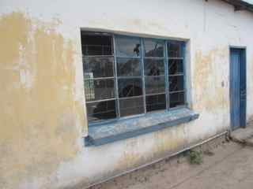
Africa, 2013!!
Mwandi, Zambia

Slide 2
The village of Mwandi
Beginning our tour of the Mission, the hospital, school and village. Gertrude is our leader and we are all standing in front of the Mission House, Simba House, where we stayed.

Slide 3
Simba House
Notice that the ‘path’ or ‘road’ to Simba house is all sand. Mwandi is either sandy, dusty, or a lush green with lovely flowers. Quite full of contrast!

Slide 4
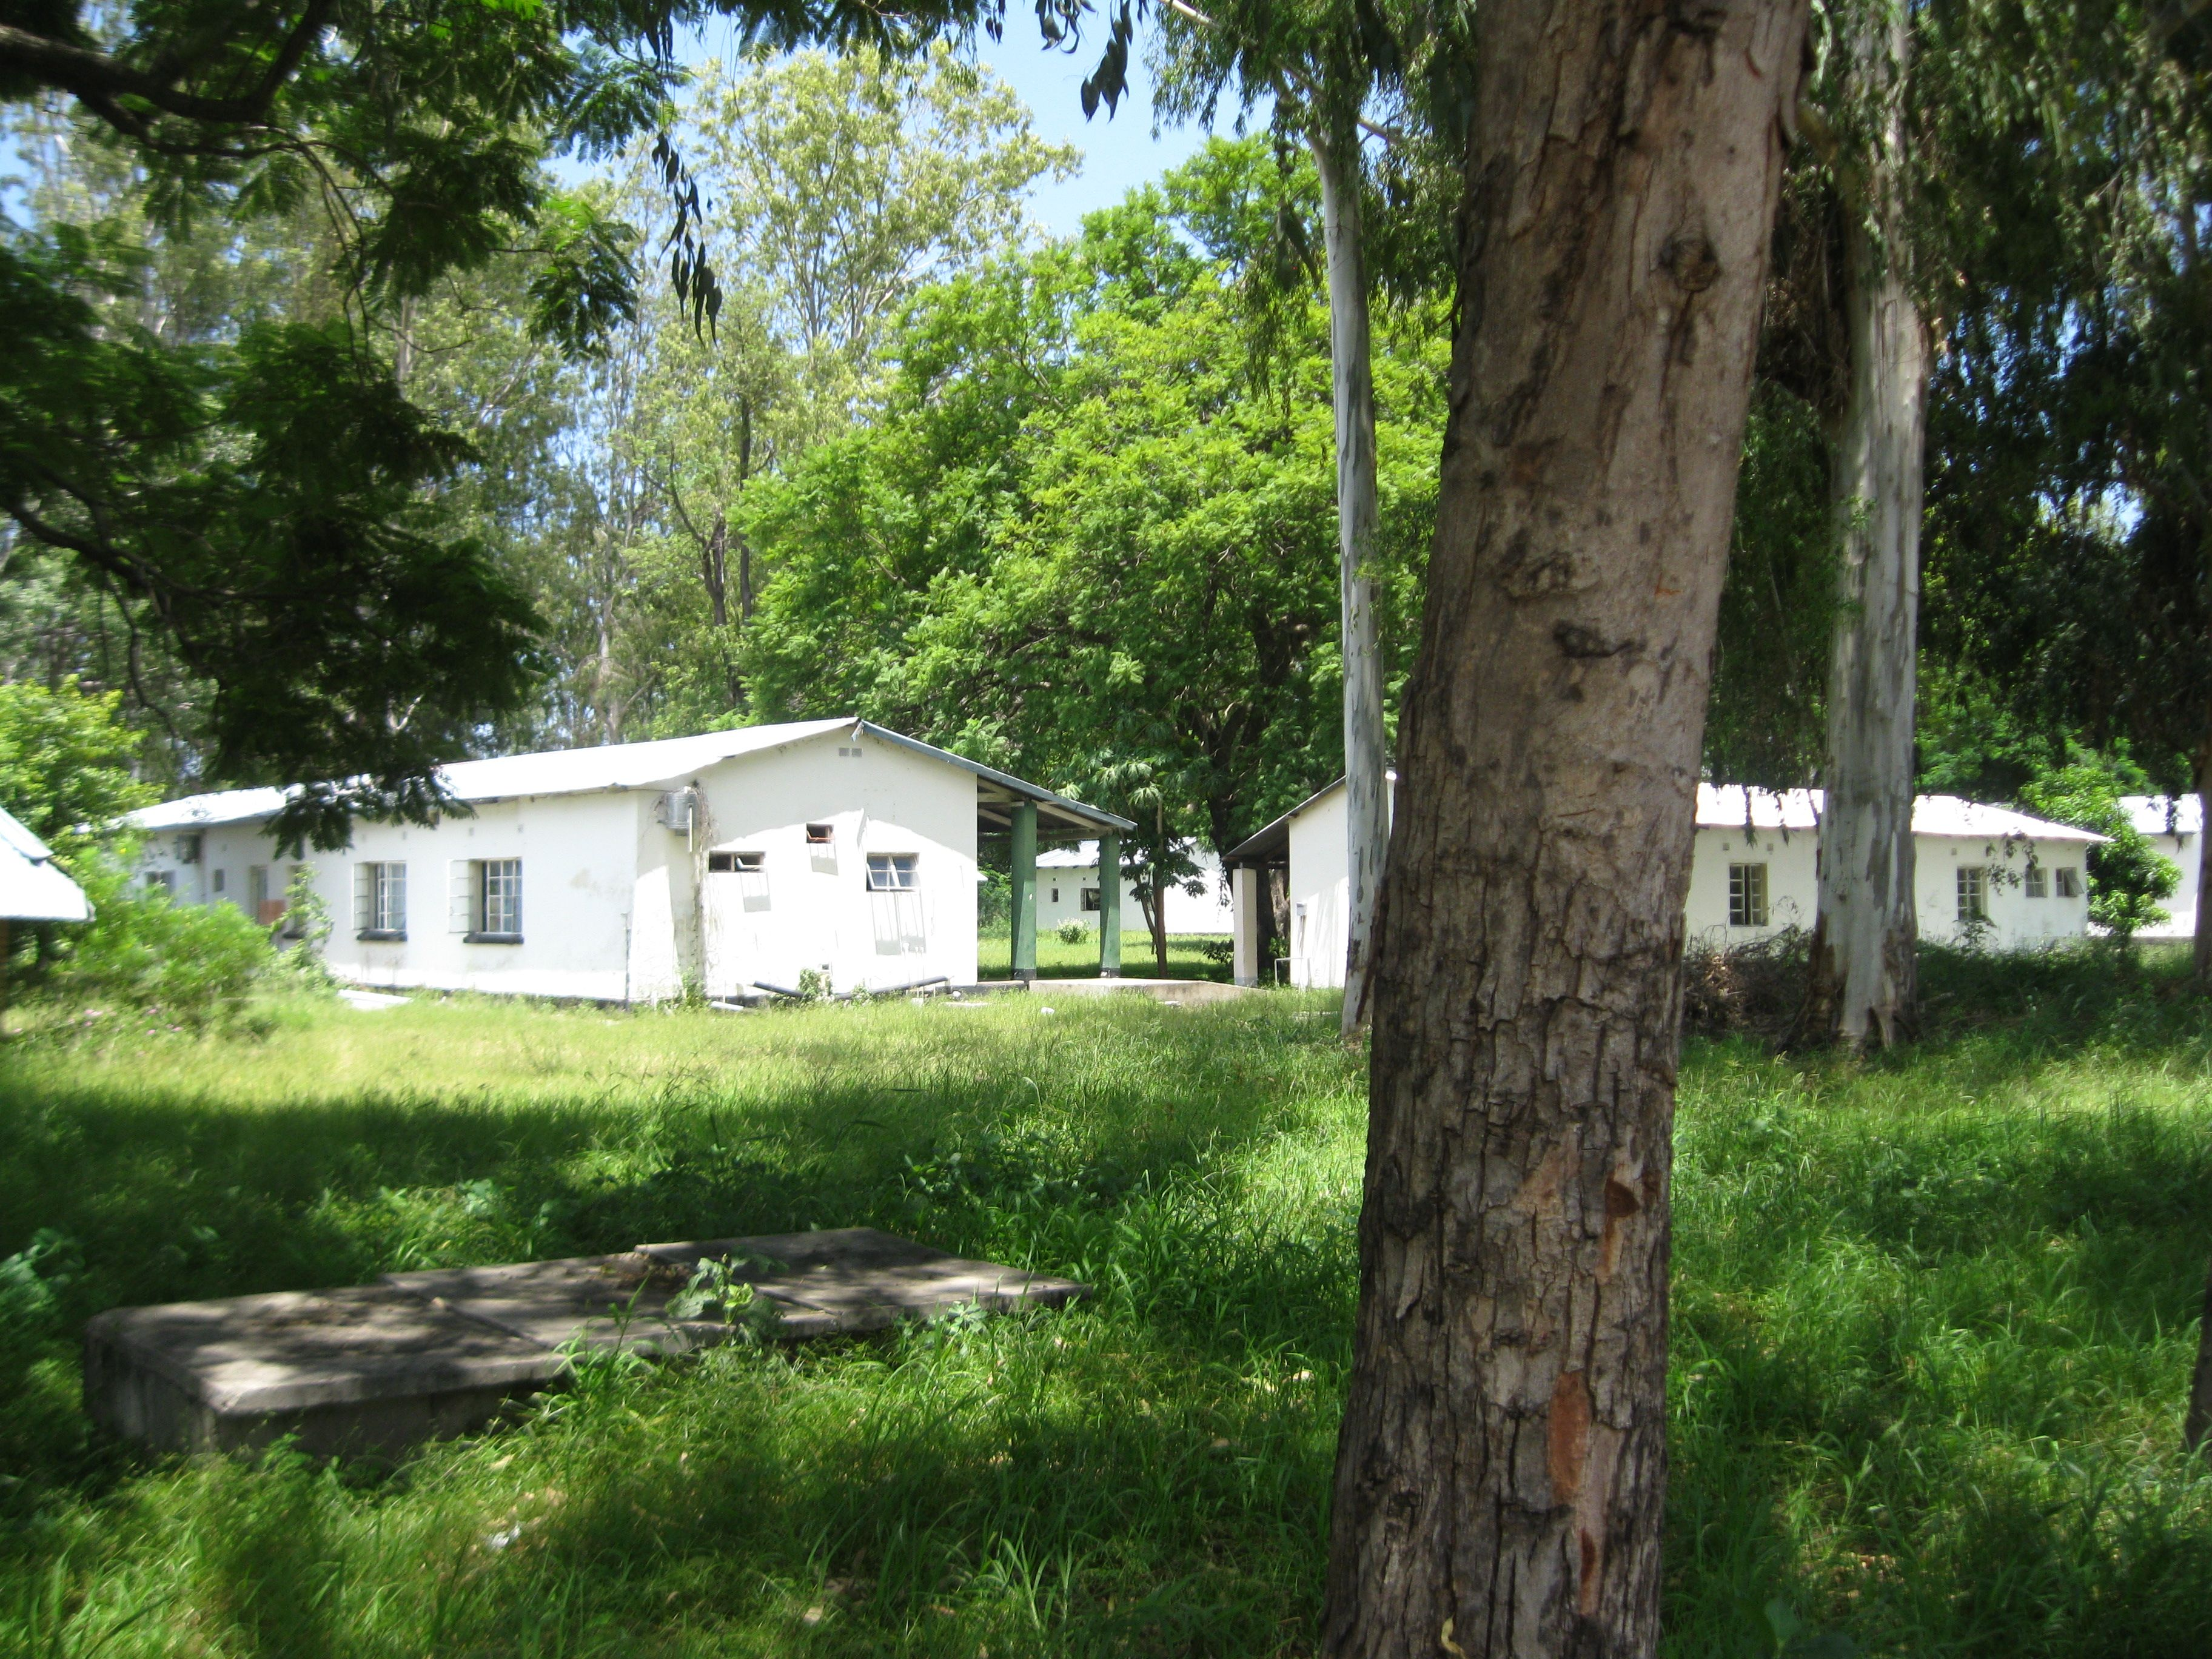
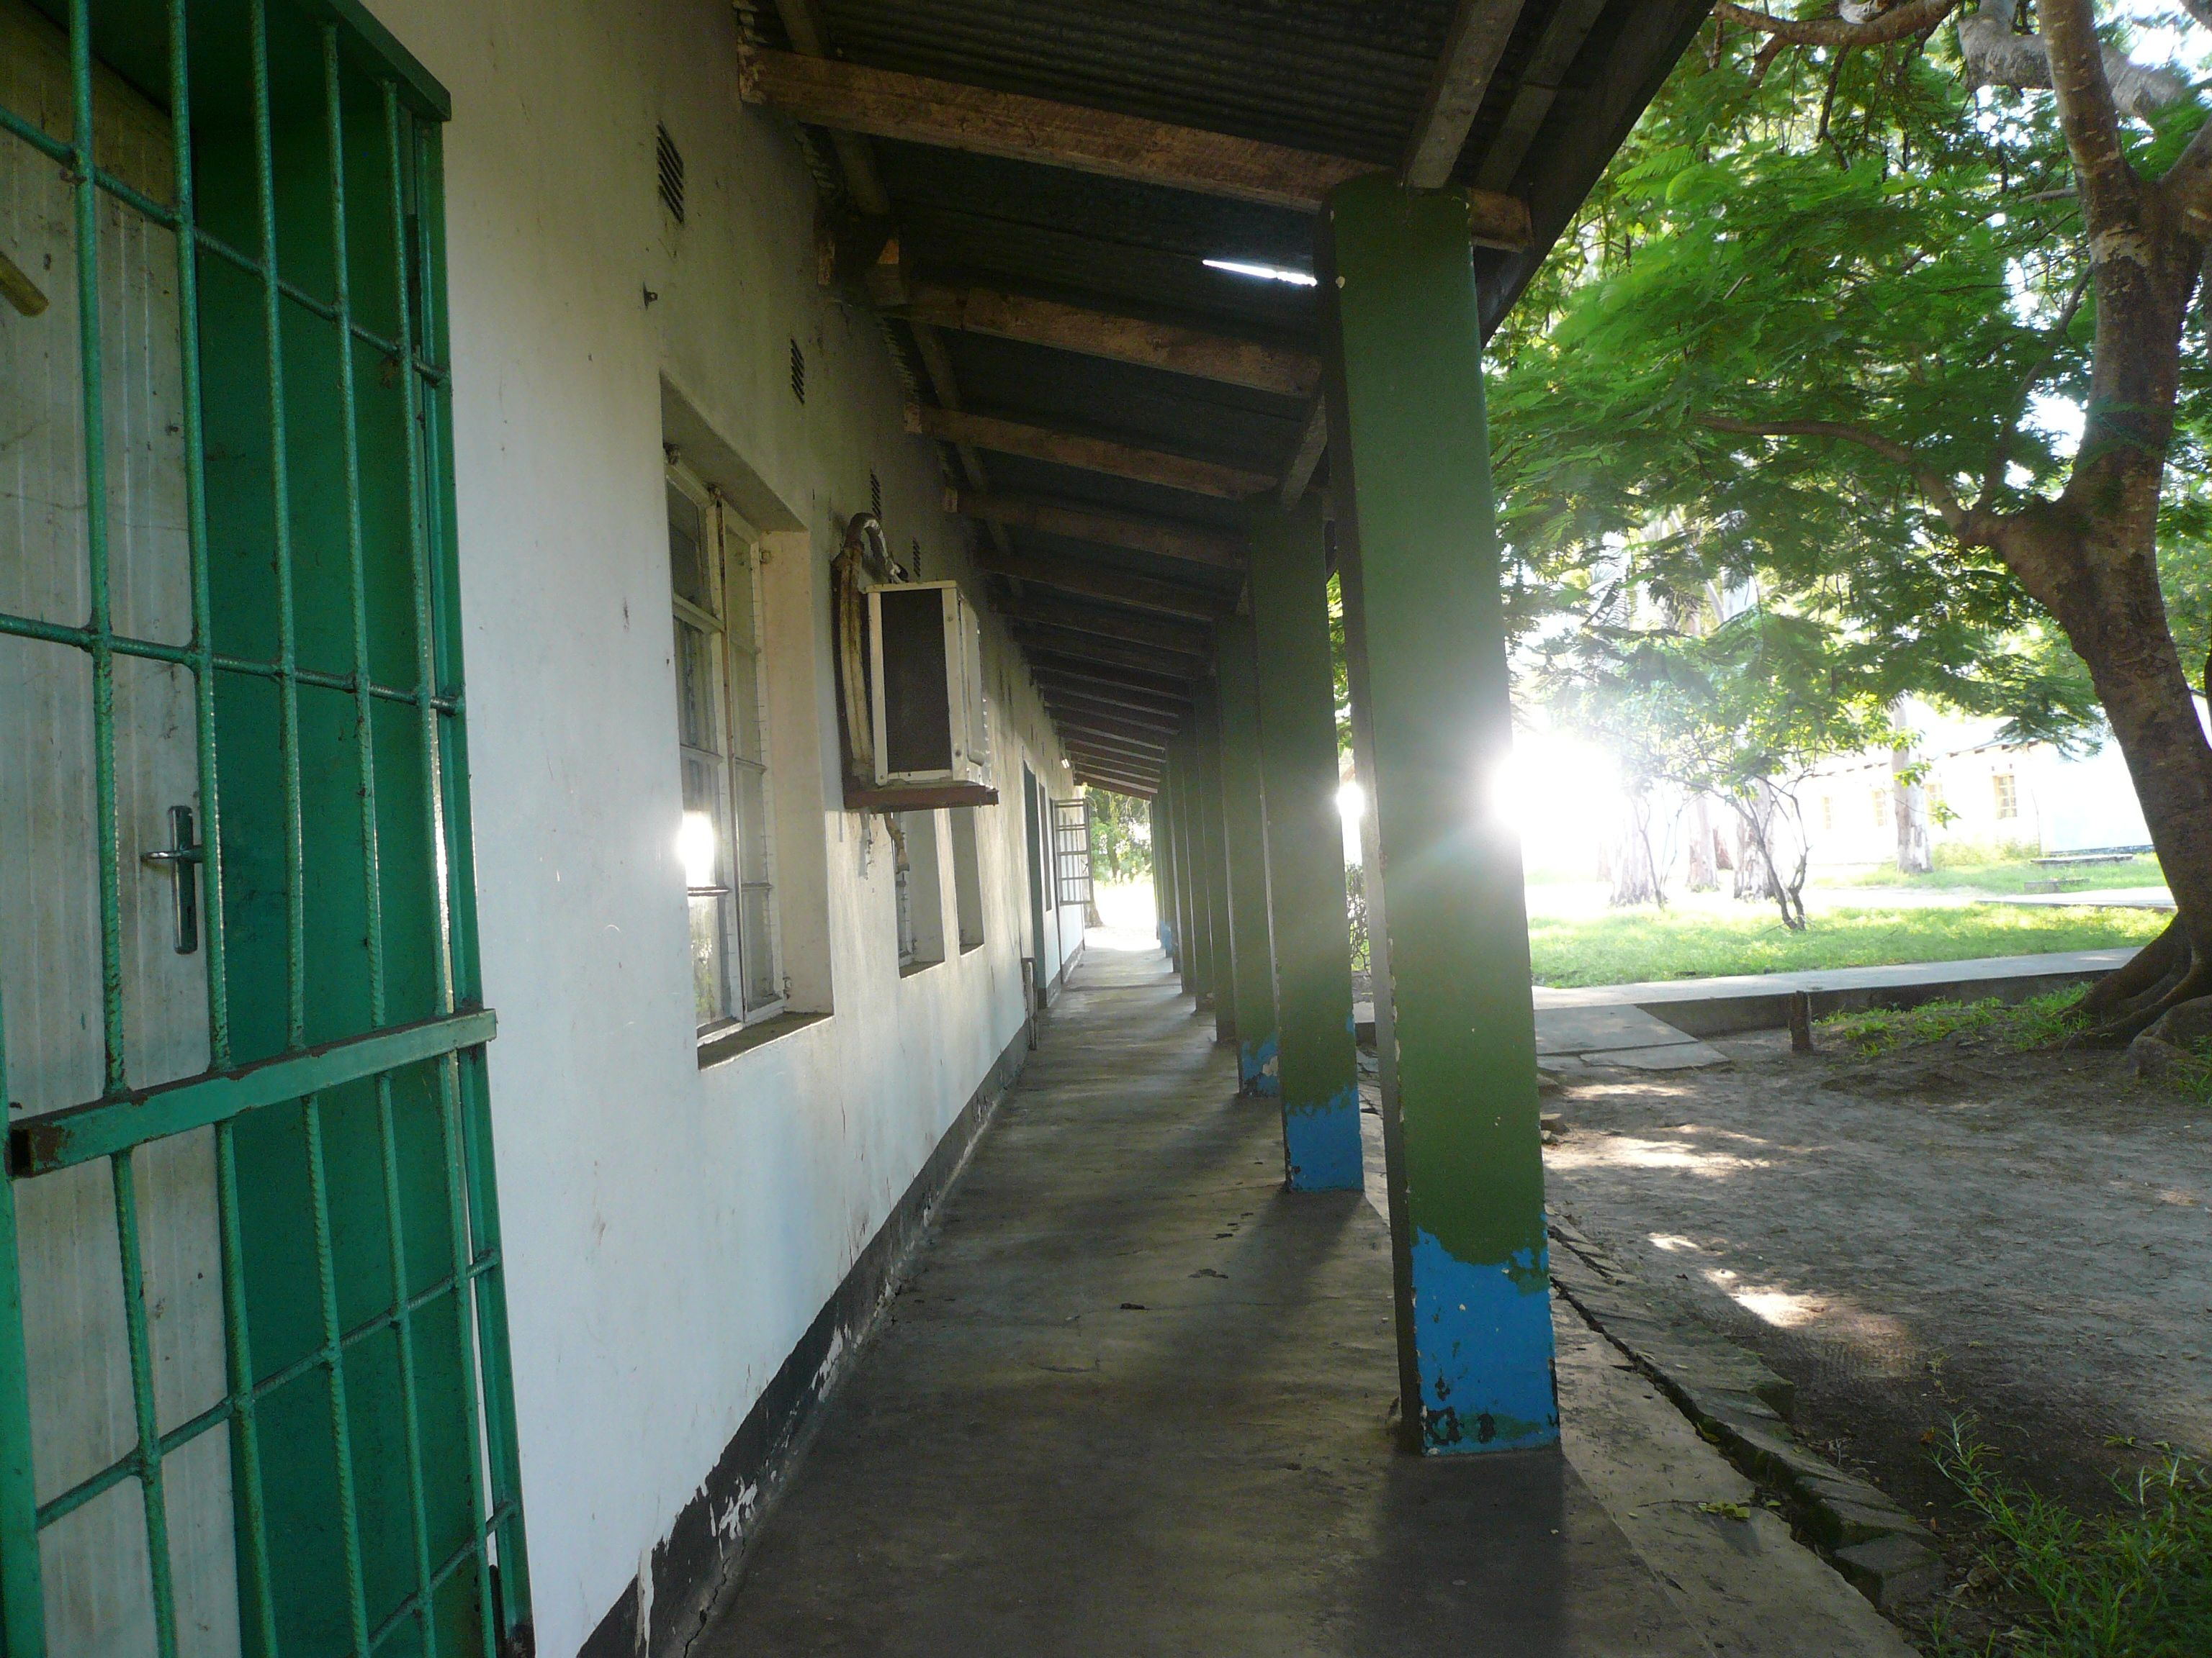
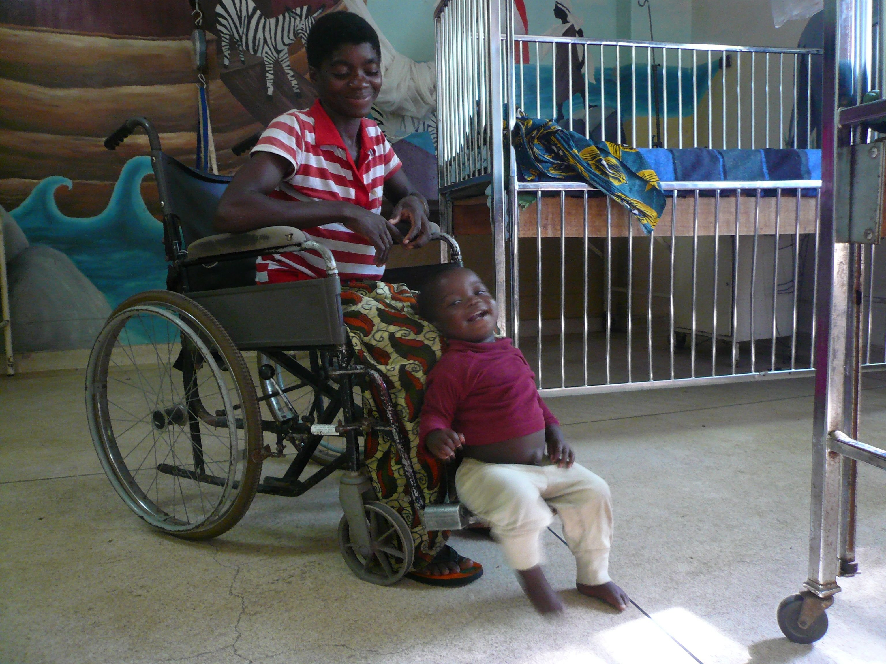
Views of the Hospital

Slide 5
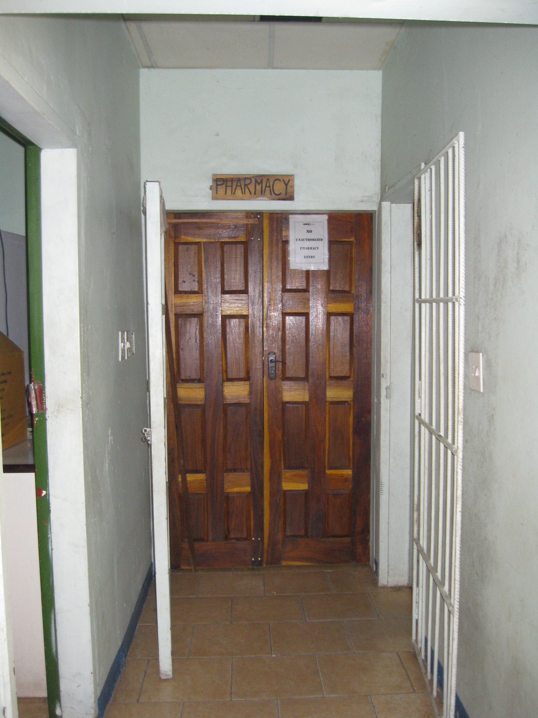
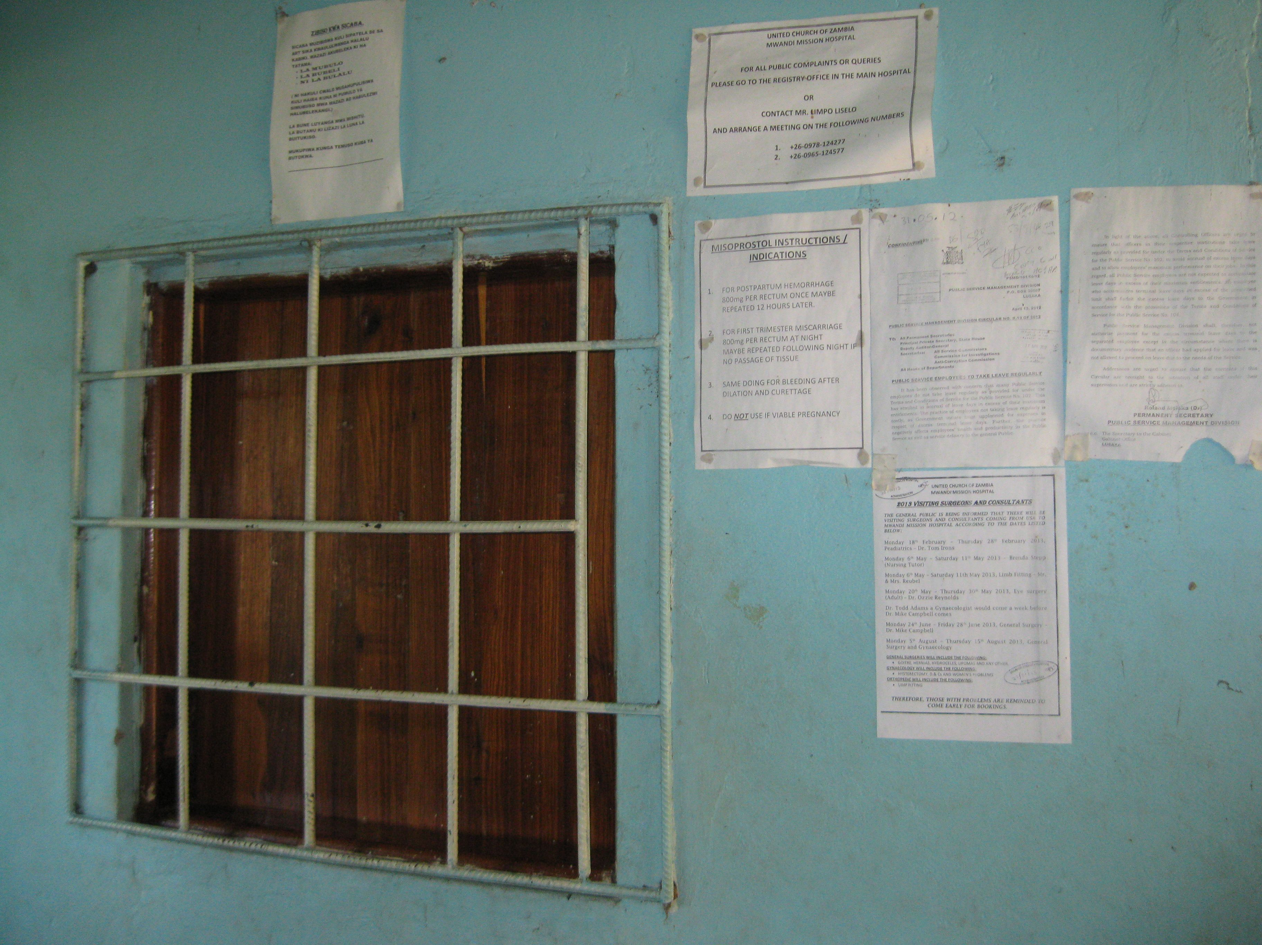
More pictures in the hospital
Pharmacy

Slide 6
Fences
This is an example of two kinds of fences. The first (in process) is fashioned from long stalks of tall grasses. The second, the shrub, is prevalent and the ‘fence of choice’ as it grows quickly and, should you rub up against it and get the milky liquid on your skin it will burn for at least an hour.

Slide 7
Entering the village

Slide 8
Thatched roofs on mud huts
All around Mwandi you see holes; holes that are being or have been dug. The sand/dirt has many, many uses, included in which is the mixing with cement/water for cinder blocks or mixing with water for mud to ‘plaster’ the sides of huts.

Slide 9
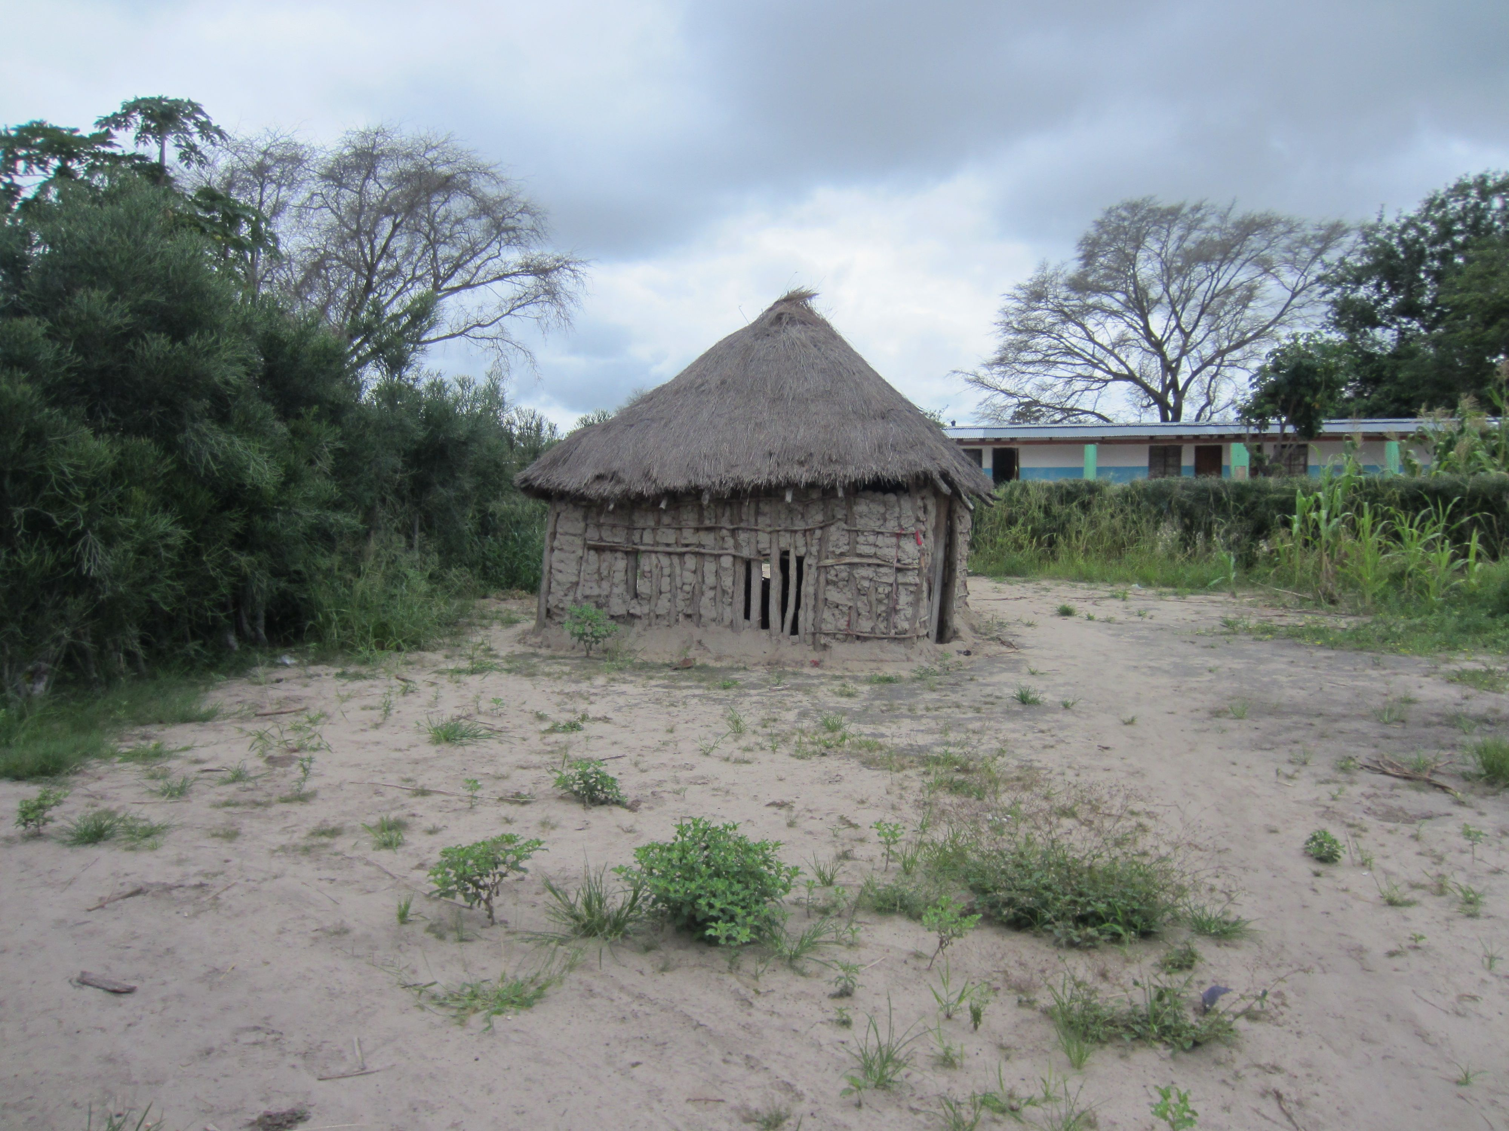
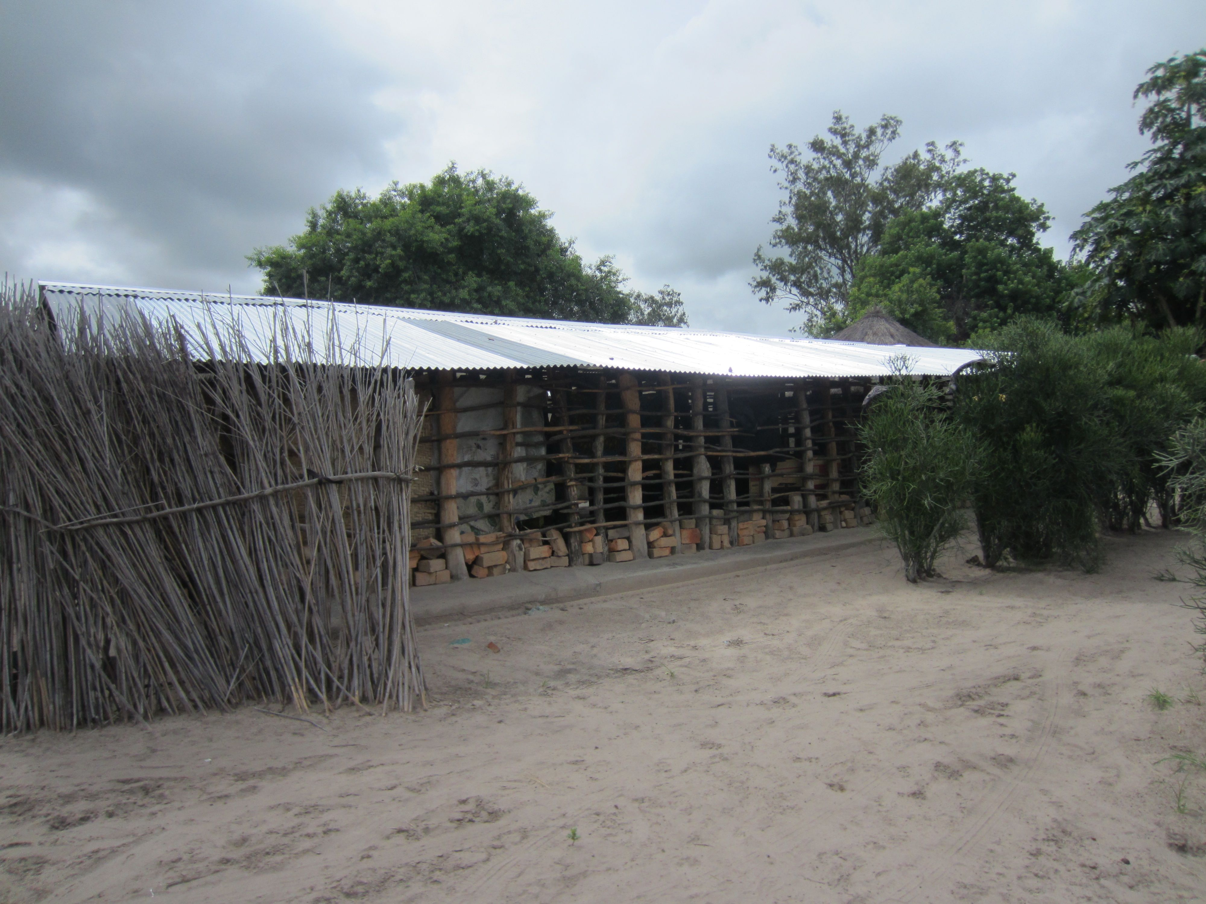
Homes in different stages
Note the two kinds of fences!

Slide 10
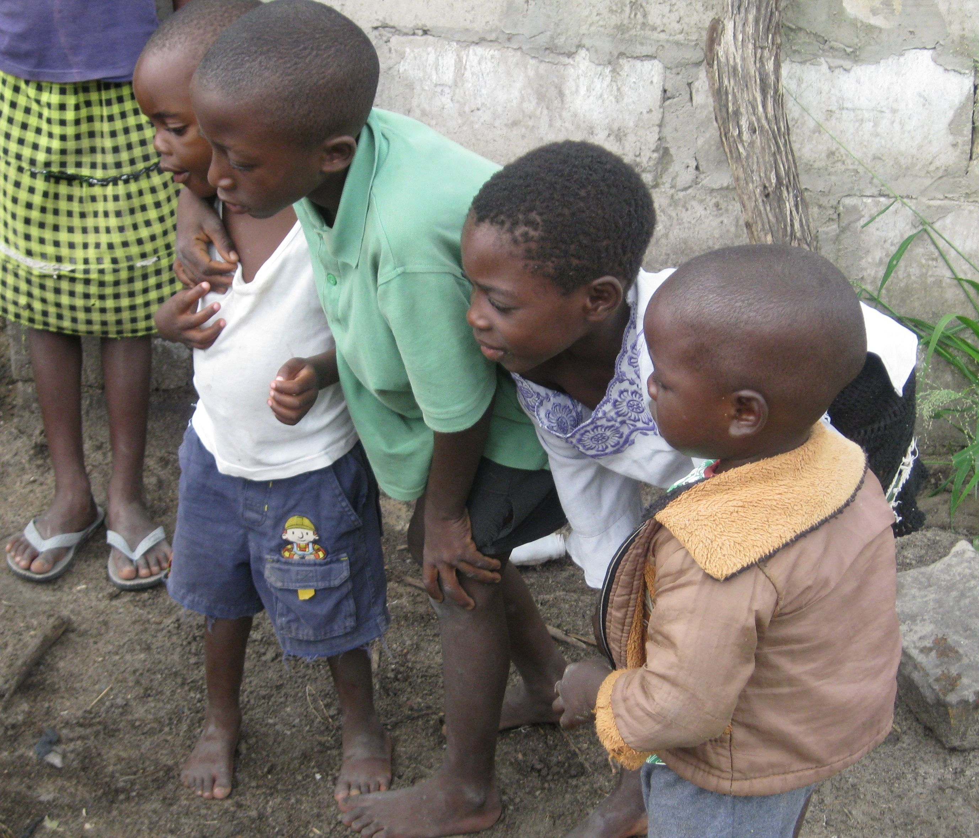
Pigs!!!
The children gathered by the pigs loved looking at their picture!!

Slide 11
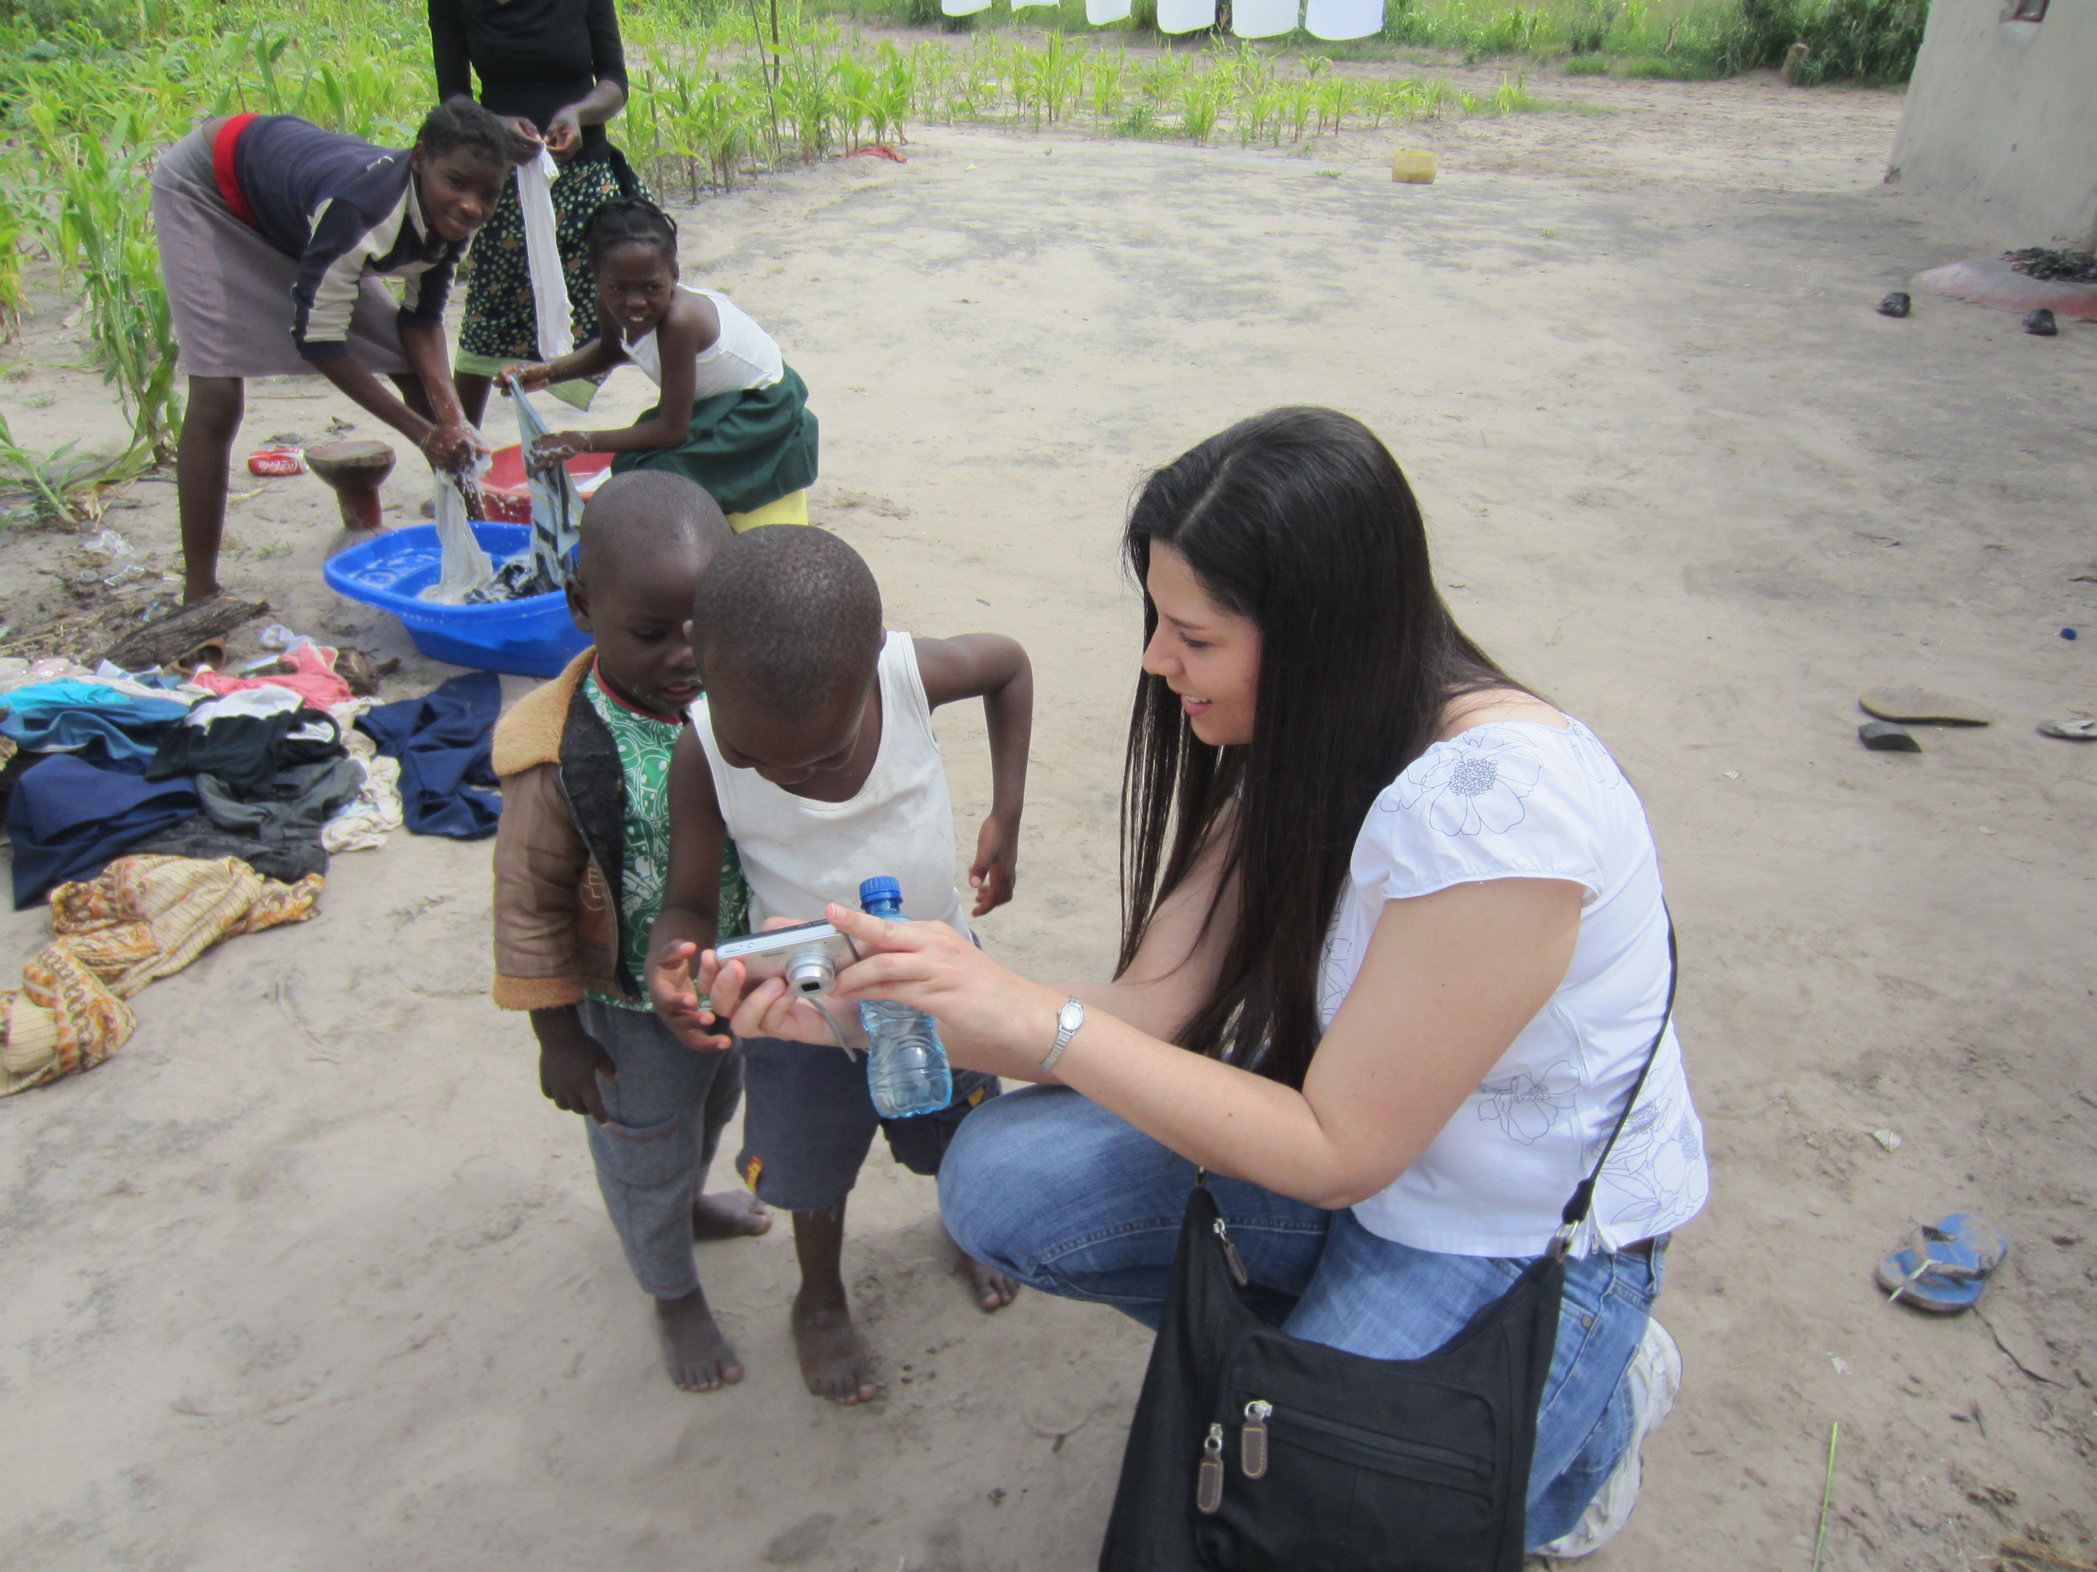
Doing the wash!
The children (and the adults!) loved to have their pictures taken and then get to see themselves!! We rarely saw a mirror anywhere!!

Slide 12
The rainy season…
…often wreaked havoc on mud homes!

Slide 13
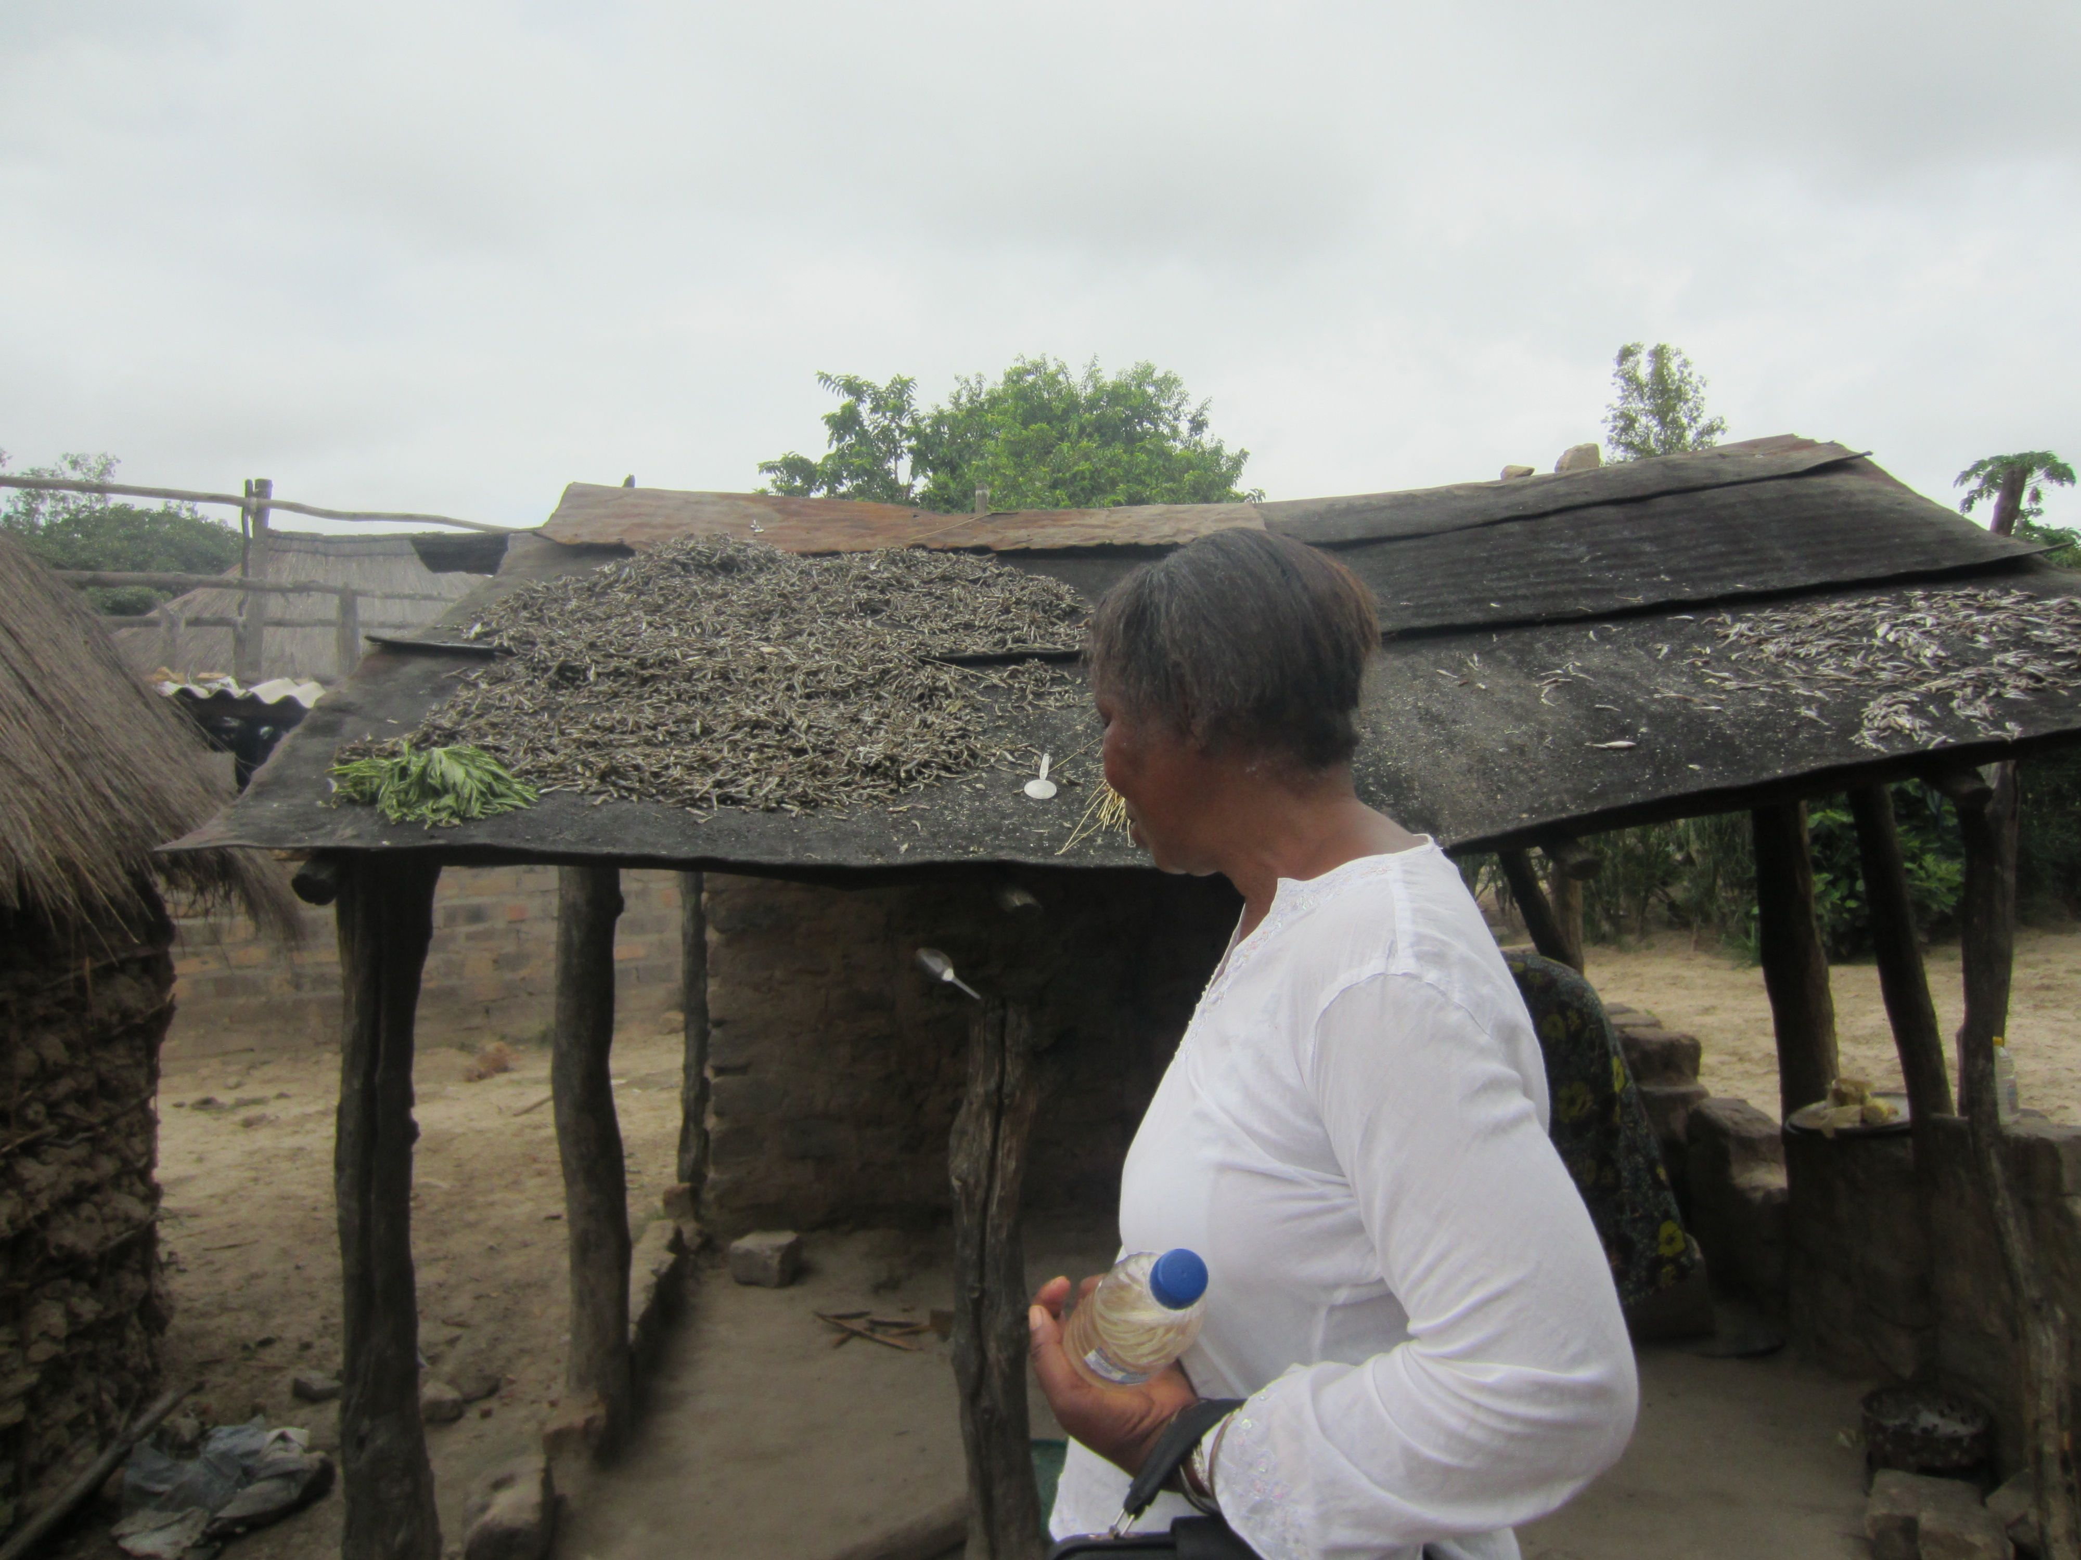
Drying fish on the roof!
What you can’t see are the flies that are buzzing all around the drying fish!

Slide 14
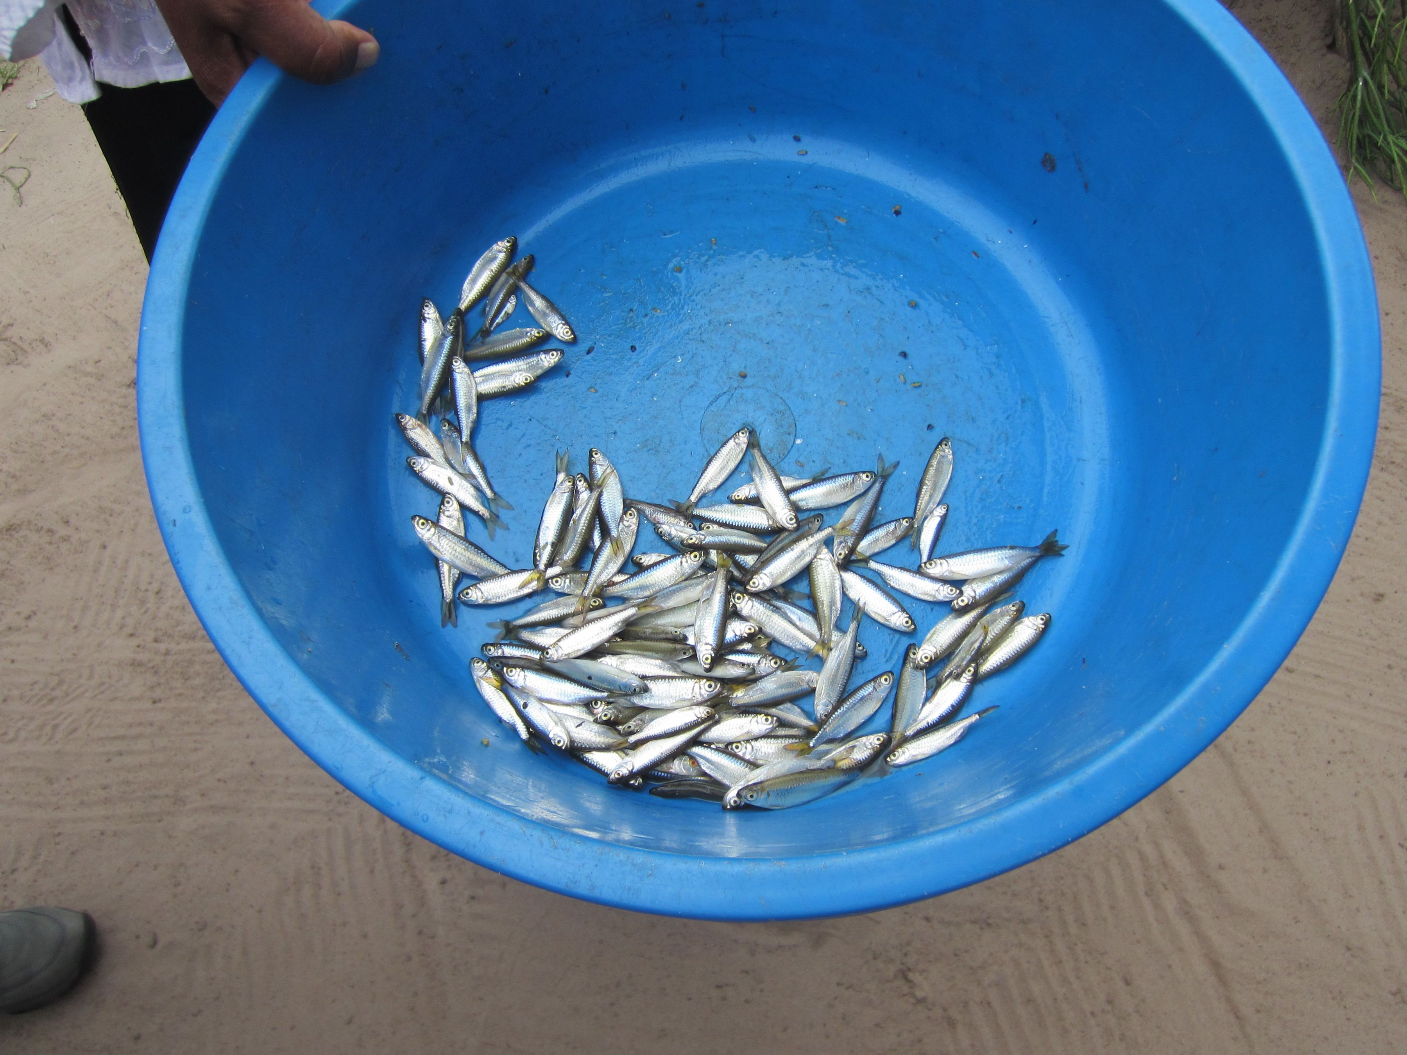
Cooking lunch
Cooking, for the majority of villagers, is done over an open fire. This woman was frying the fresh, small fish, the same kind that you saw drying on her tin roof! She caught them that morning in the Zambezi by throwing in a net or a cloth and ‘scooping’ them out.

Slide 15
Eating her nshima on the step.
Nshima is a staple of Zambia made by mixing corn meal (maize) with water until a stiff paste forms. (It is like what we call polenta.) It is then molded in the hands and used to scoop up gravy or juices. In Livingstone, sitting outside at a table, I watched many people use the nshima almost as a utensil. On the sidewalk near me was a large jar of water which they used to wash off their hands when done.

Slide 16
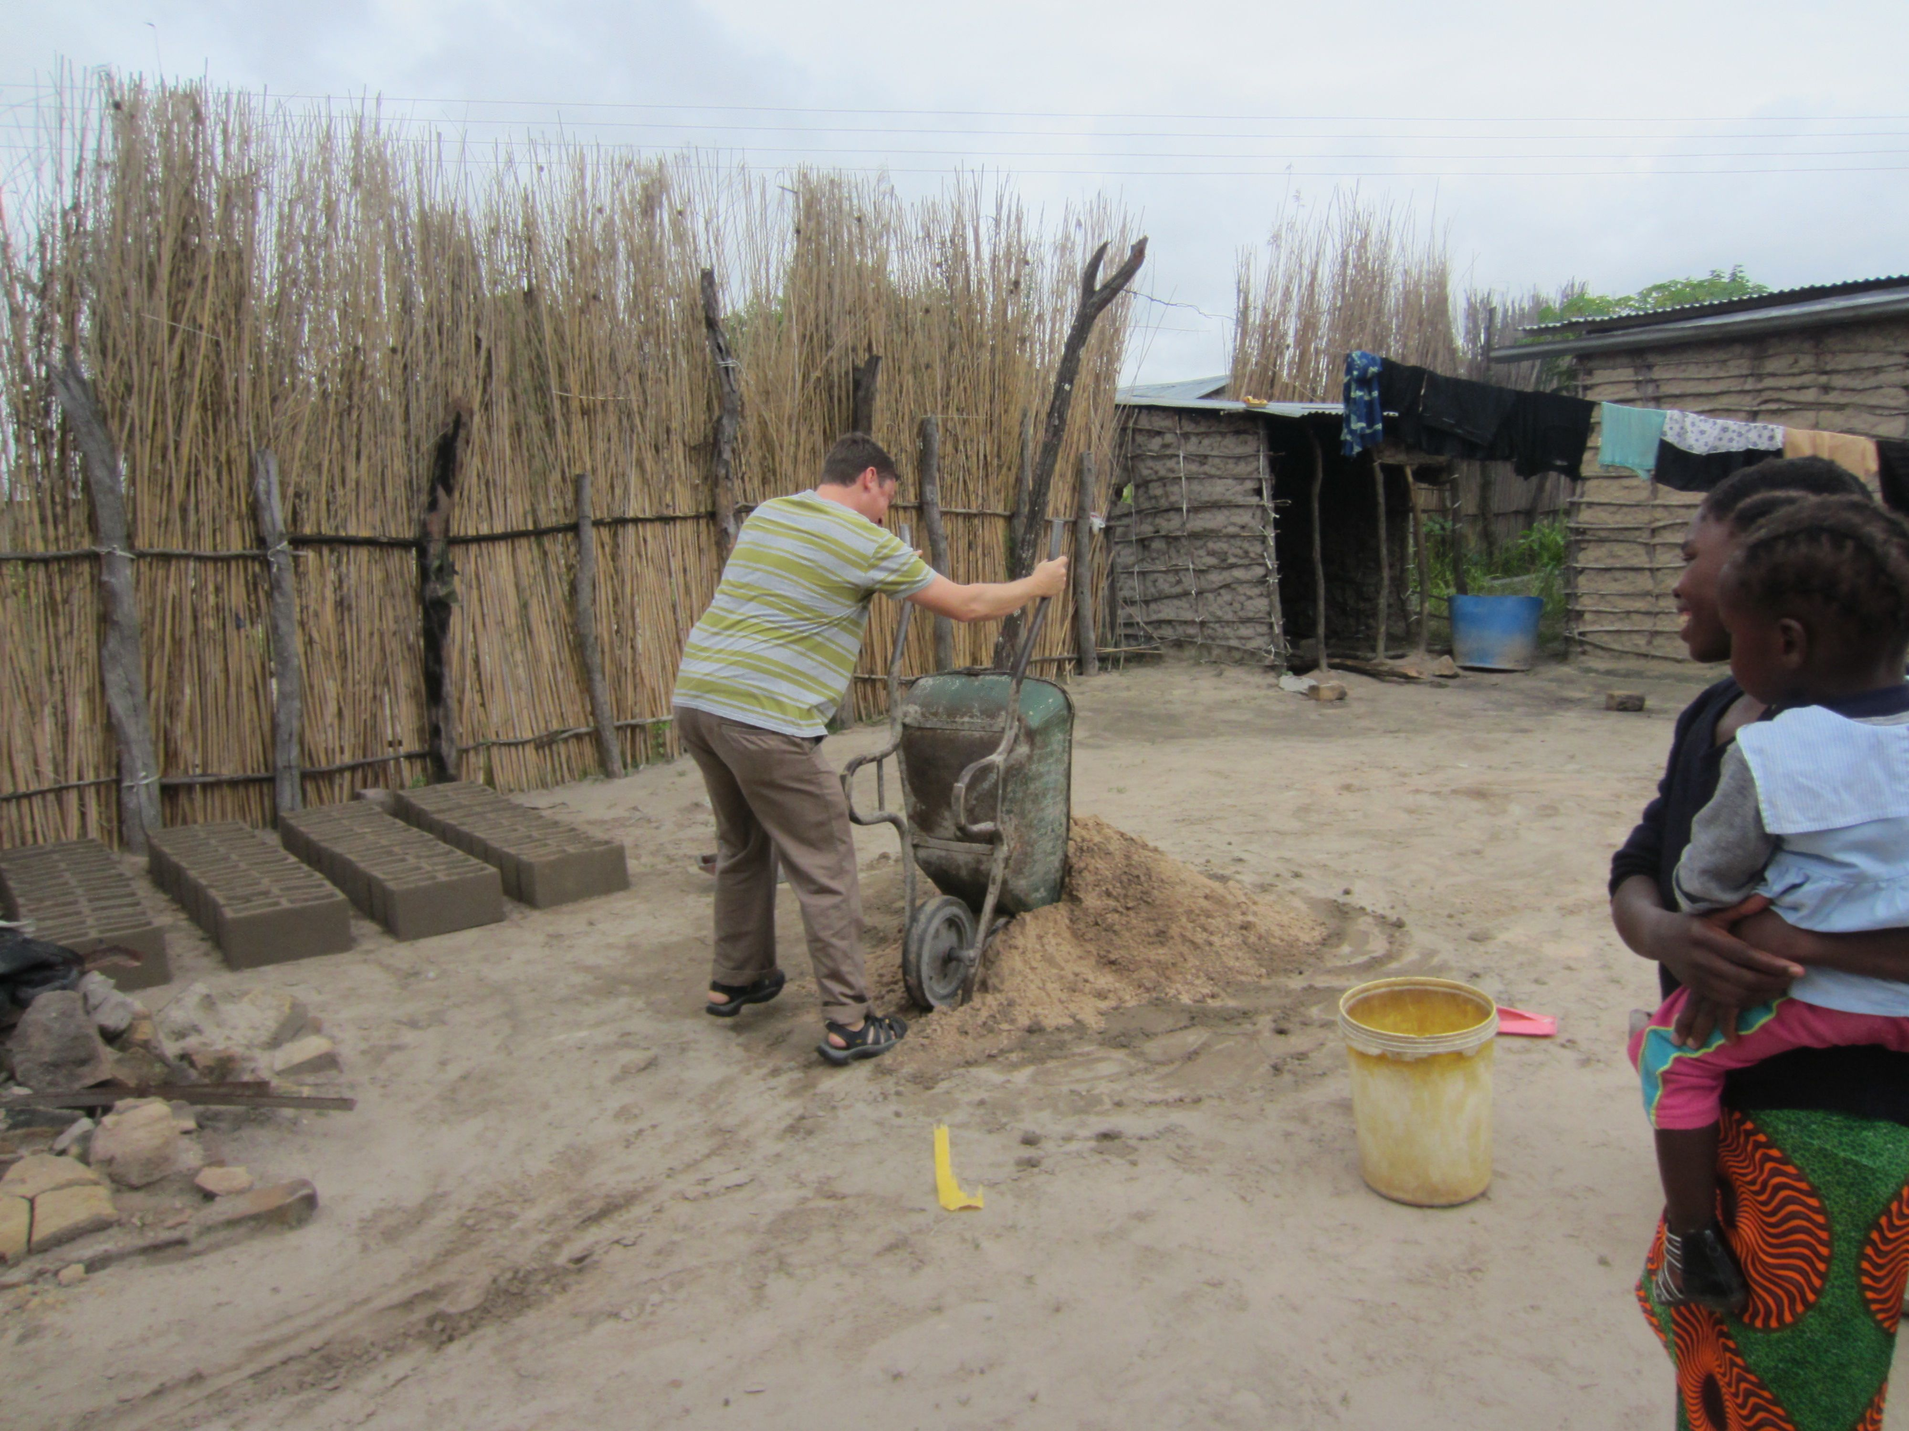
Holes!!
Remember what we said about holes?? These children were digging and playing in a typical-sized one. In the picture at the bottom, Jason, one of the med students, is ‘helping’ the villager as he mixes the sand from his hole with water and cement to make cinder blocks for his home.

Slide 17
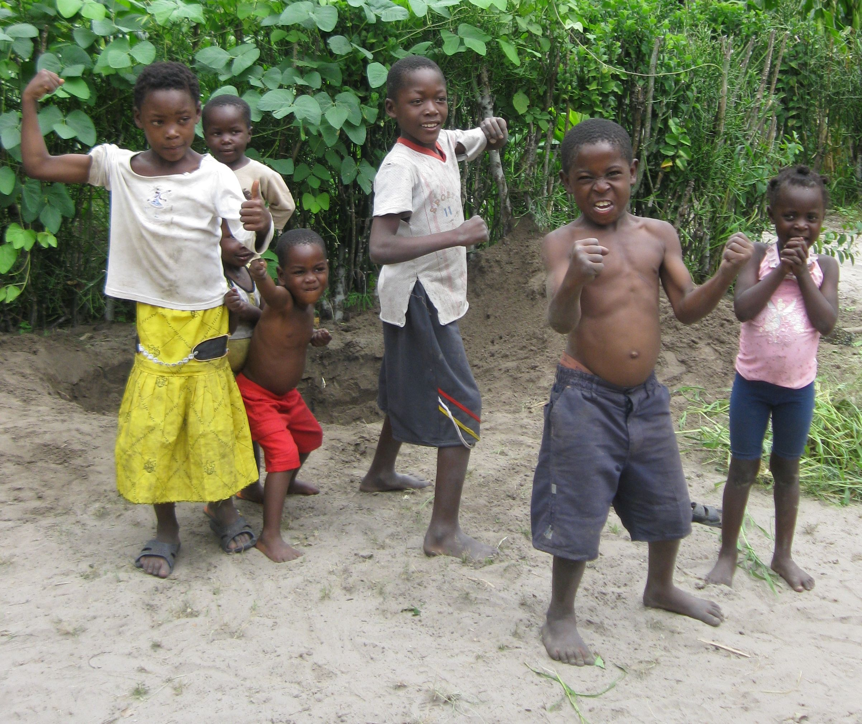
Posing!!!!
The children not only loved to have their picture taken, they loved to pose!! Not much different from Georgetown children, huh??

Slide 18
Maize: A Mwandi staple and cash crop!

Slide 19
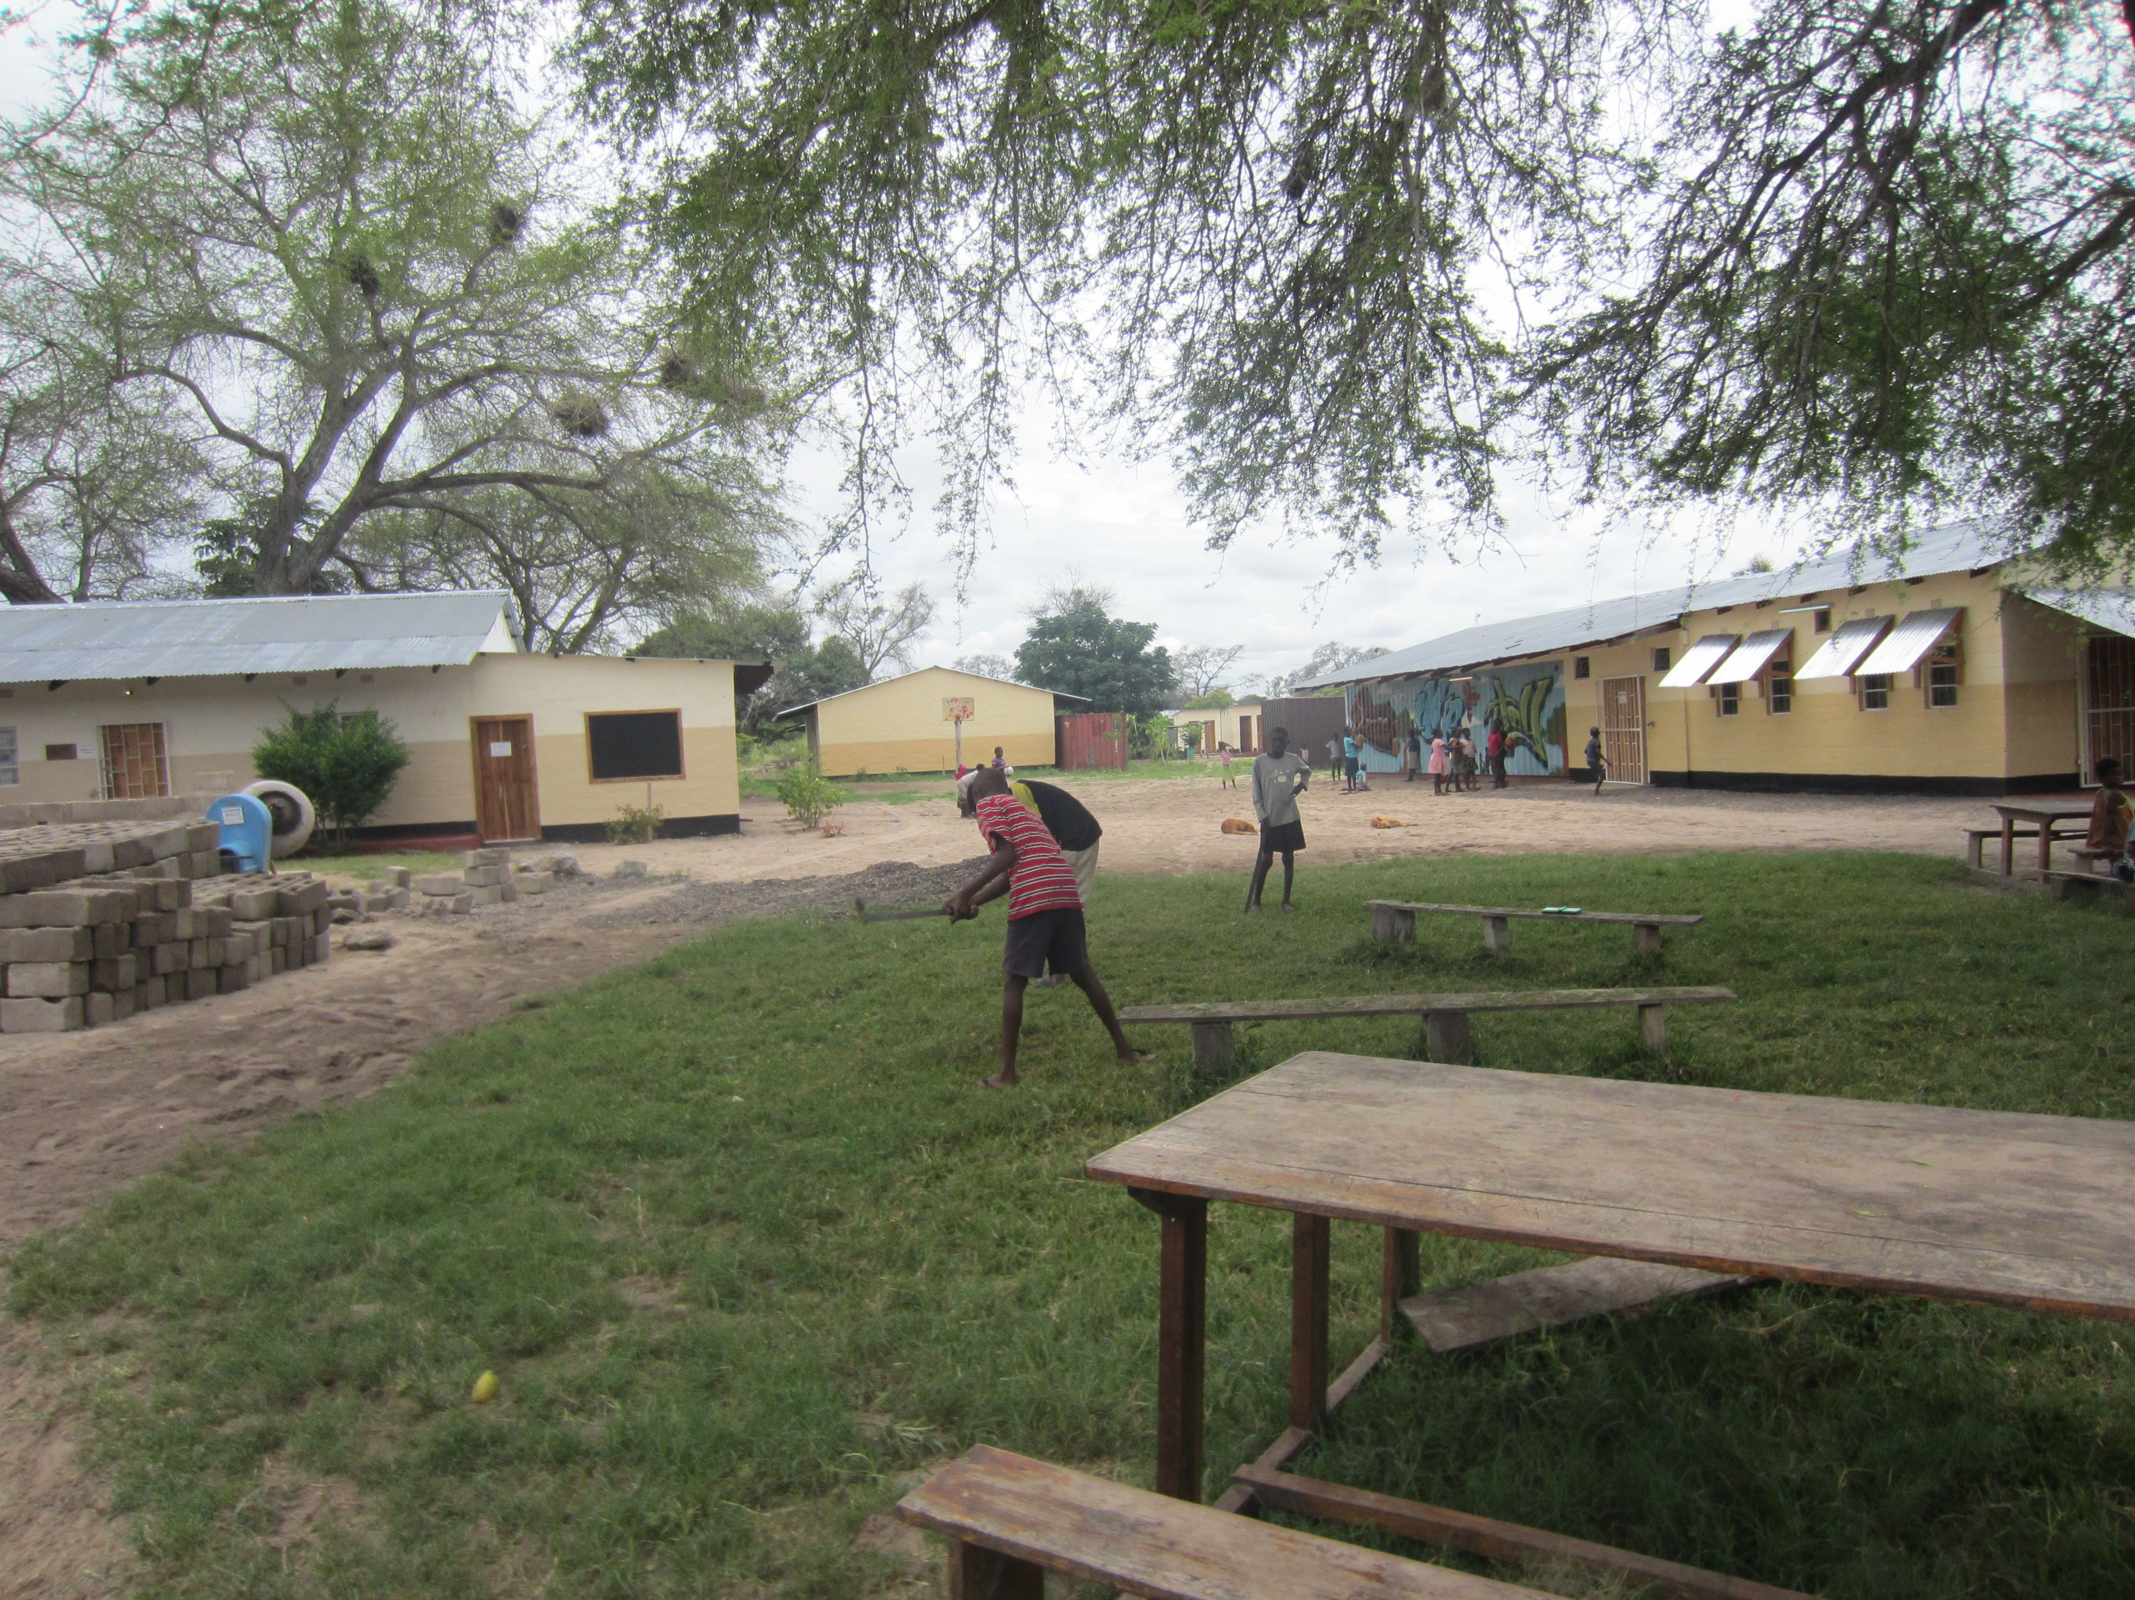
OVC (orphans and vulnerable children)
The OVC is a mission program that feeds and cares for up to 280 children for up to 9 hours each day except Sunday, children who have lost one or both of their parents. Often, if both parents are dead, the children will be living with a neighbor or relative. If they are of school age, they will go to school during school hours but still go to the OVC for lunch and after school. It was on those 280 children that our doctors did physicals, de-wormed each one, and met with parents, provided medicine, further testing, and any follow-up care necessary.
The shower where OVC children get a bath on Saturdays.
Cutting the grass…using a scythe!

Slide 20
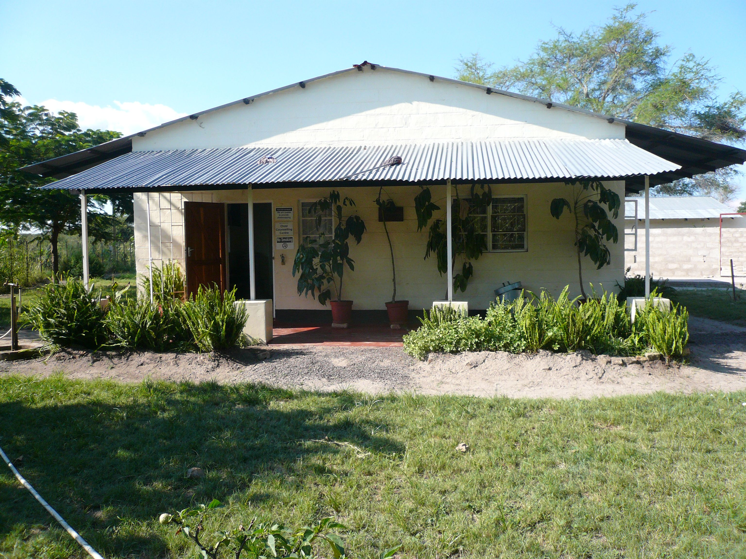
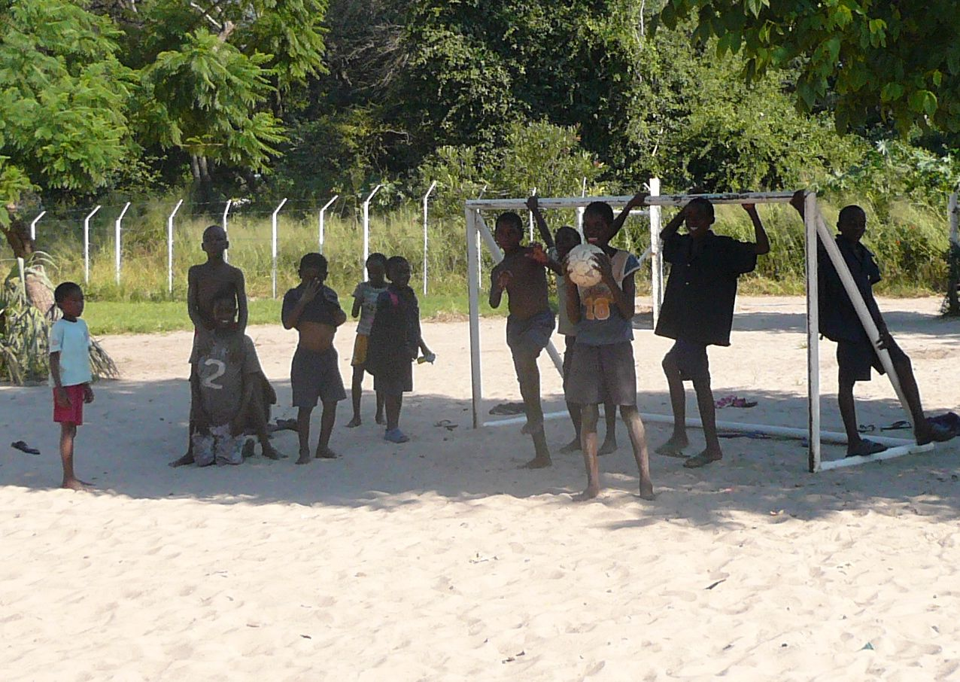
More pictures at the OVC

Slide 21
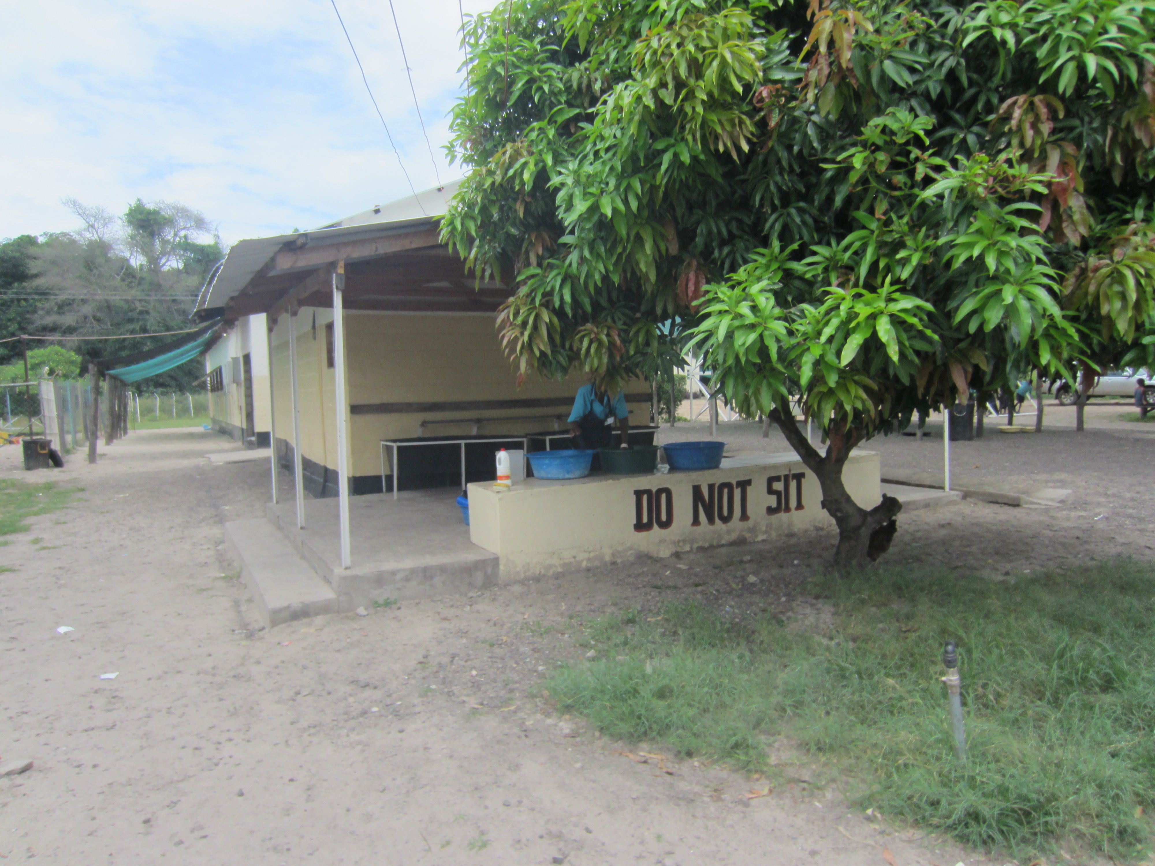
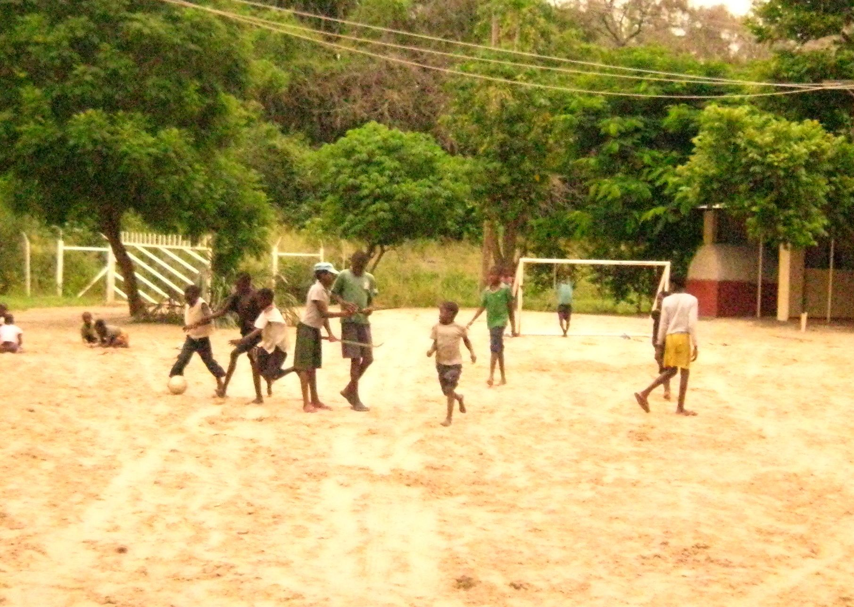
Soccer, games, dogs and chickens!
The OVC provides 280 children a safe and caring environment in which they are fed a hearty meal daily, nurtured, given some religious instruction, and afforded healthy role models with whom to interact.

Slide 22
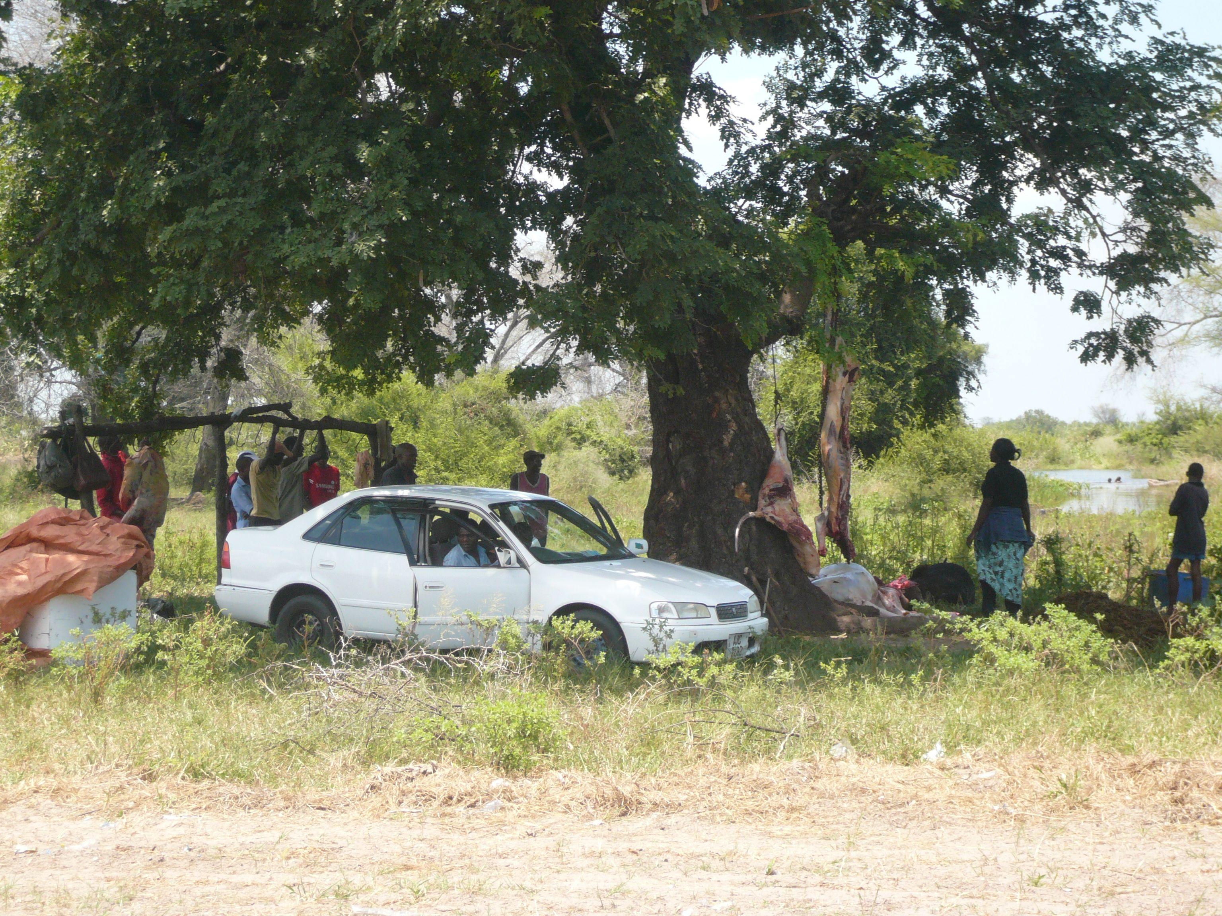
Watching a cow being butchered

Slide 23
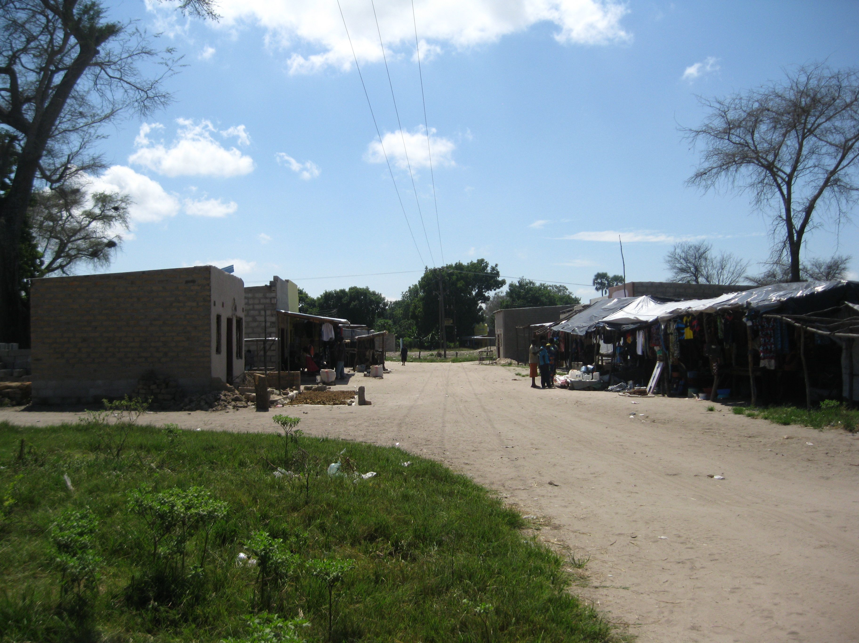
Heading into the village business district

Slide 24
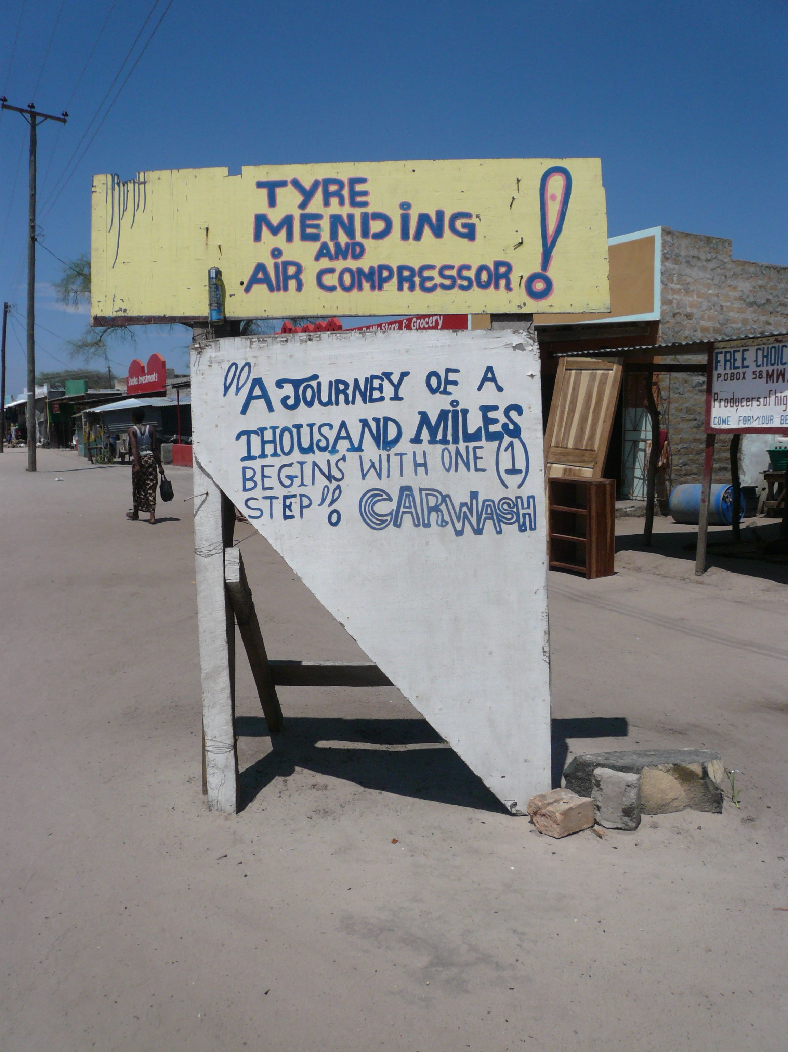
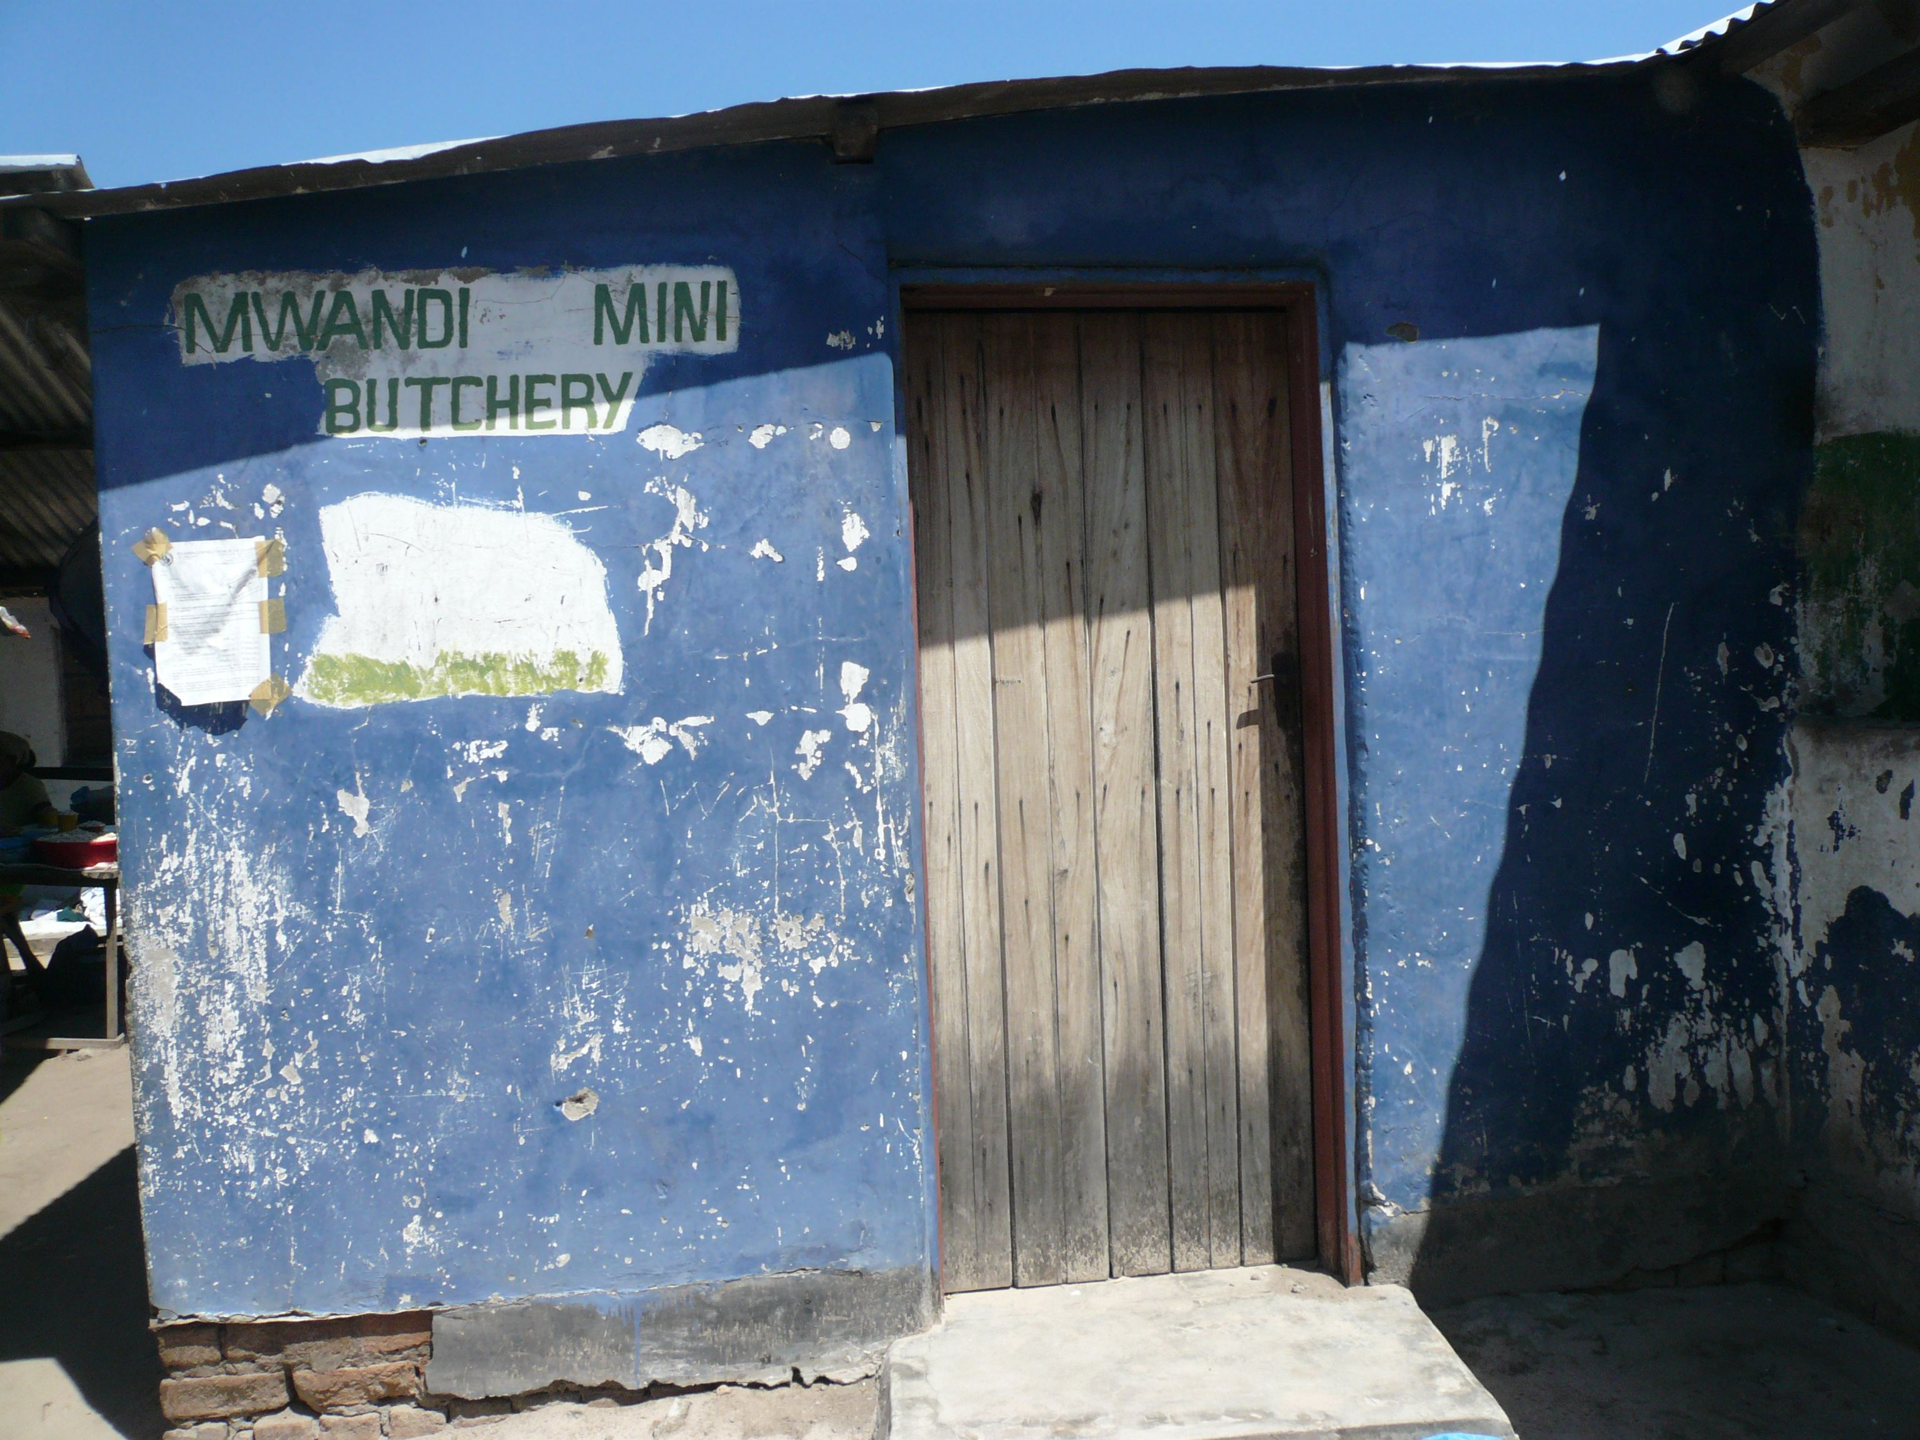
Village shops

Slide 25
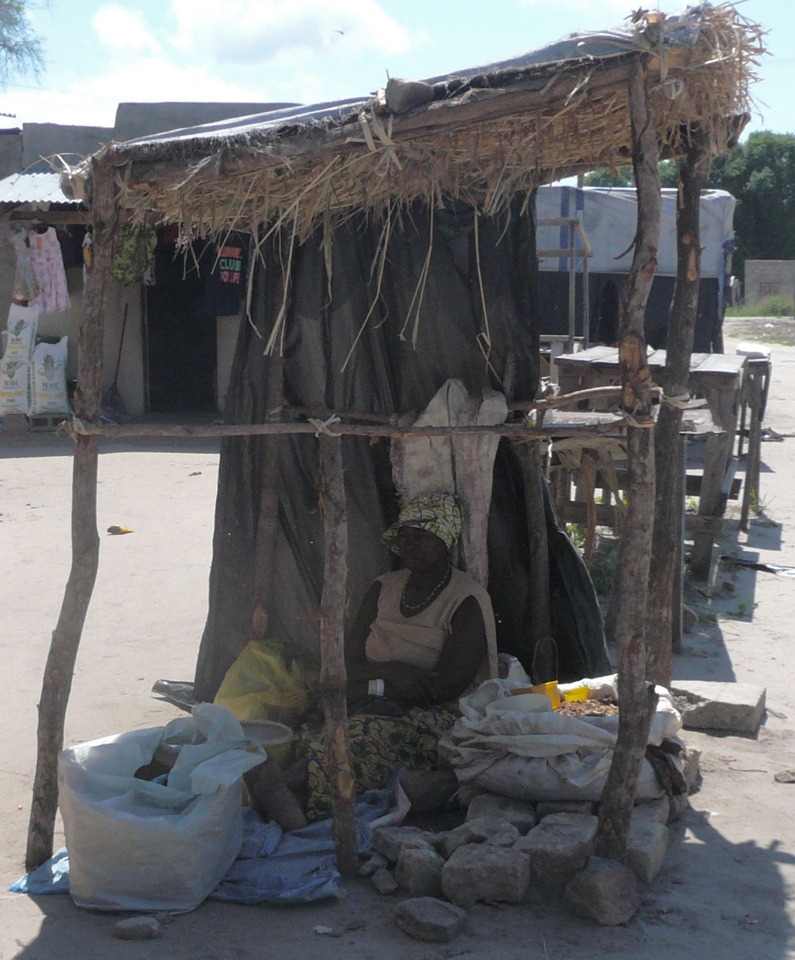
A make-shift shop and goods for sale

Slide 26
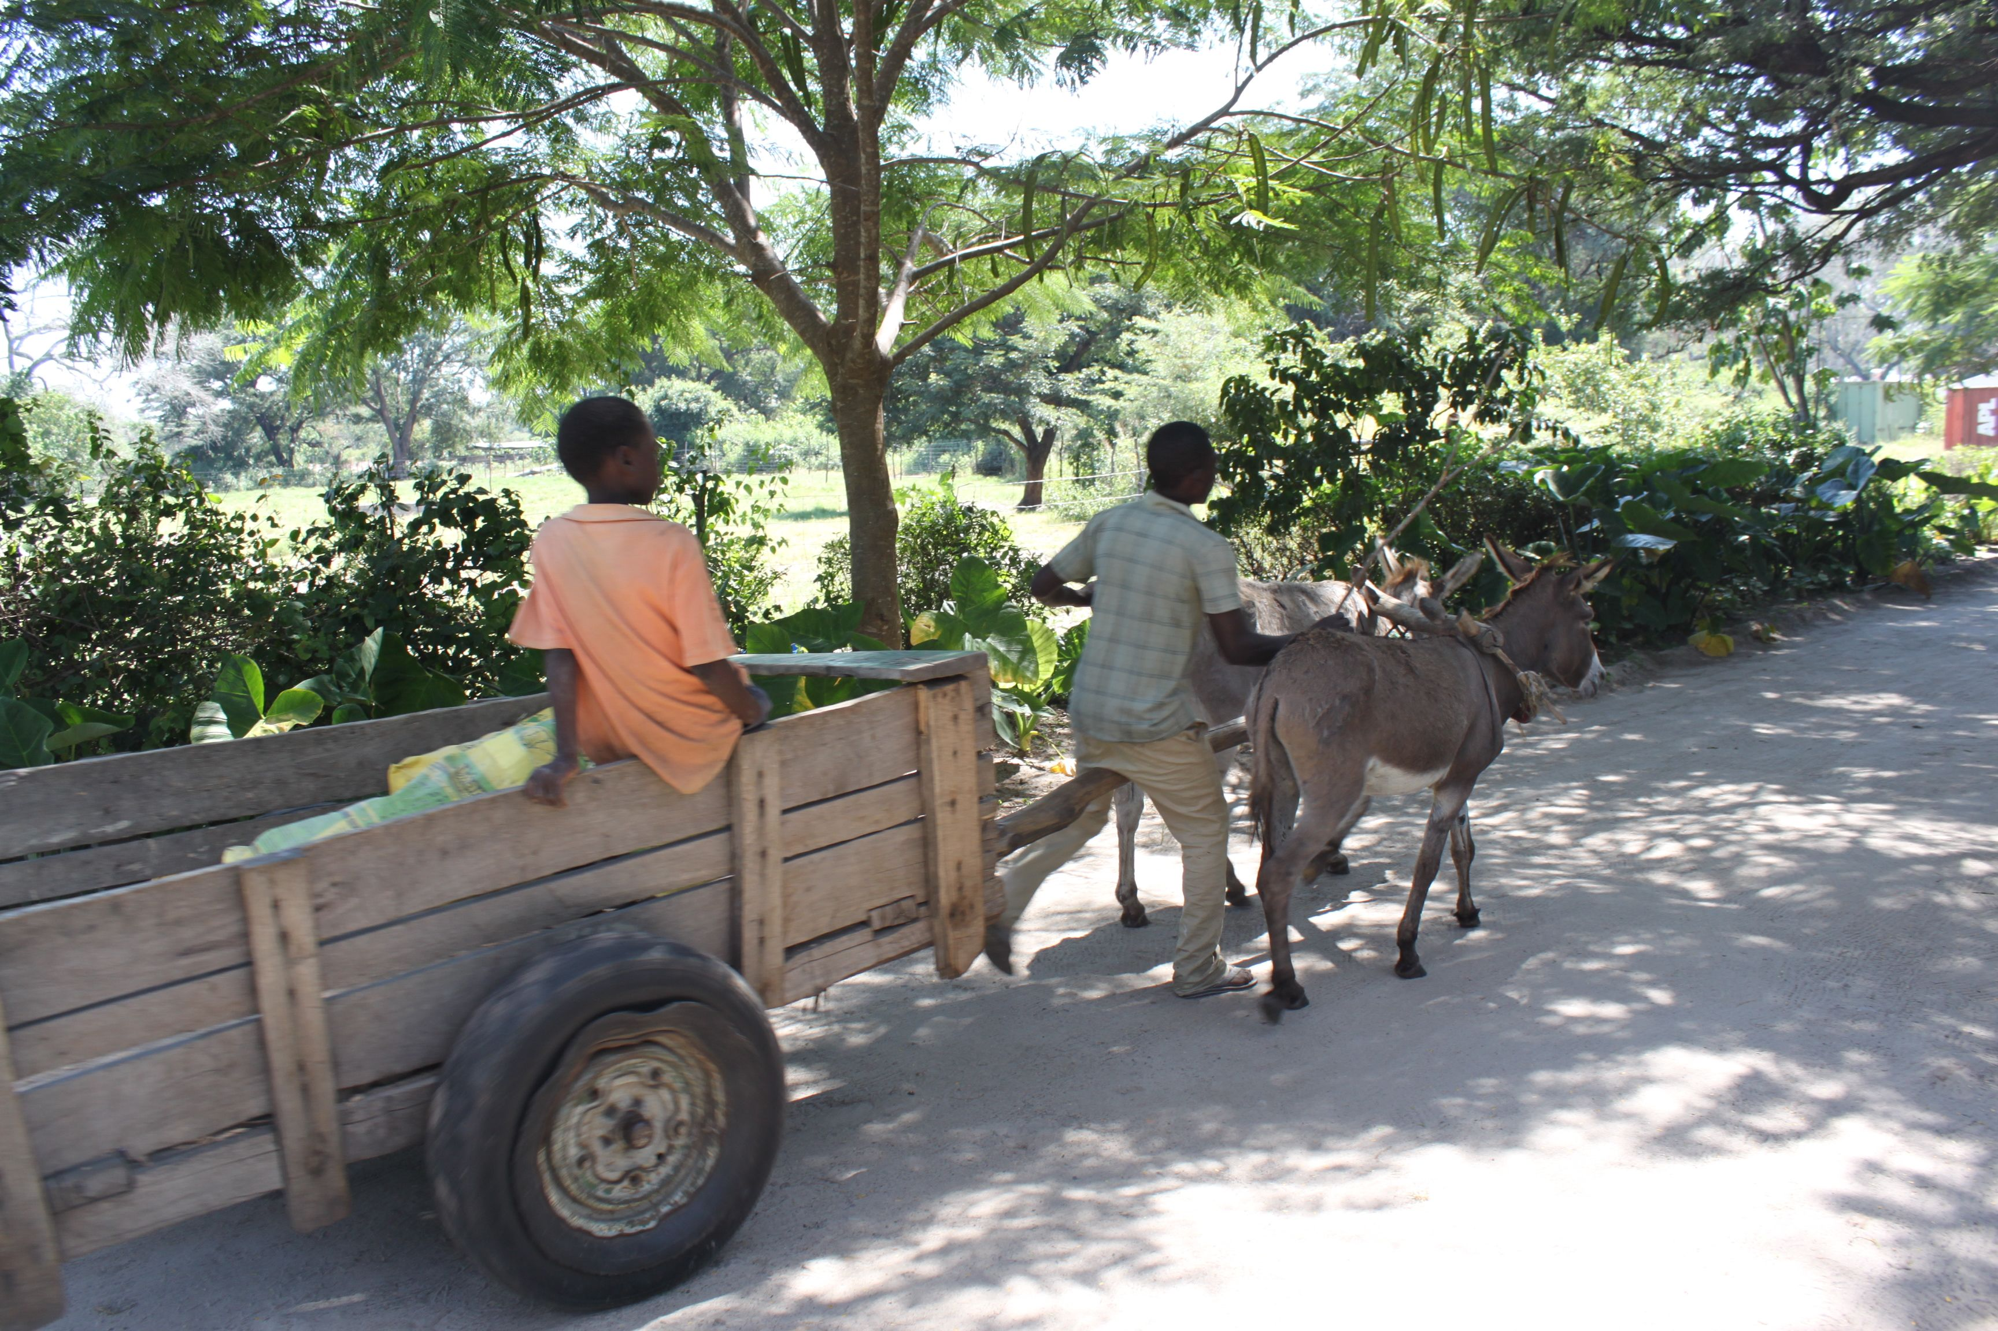
Donkeys!!
These frequently-seen animals provide transportation as well as serve as beasts of burden, carrying, dragging, and pulling materials from one place to another. Watch out!!

